Slide 1

Al-Amal Express system

Slide 2
Al-Amal Express A special system for Al-Amal Microfinance Bank that enables the bank’s branches and agents to use the following services
Al Amal Express System
Al-Amal Express transfers
External transfers
Coverages and transfers
Pace Services
Project transfers

Slide 3
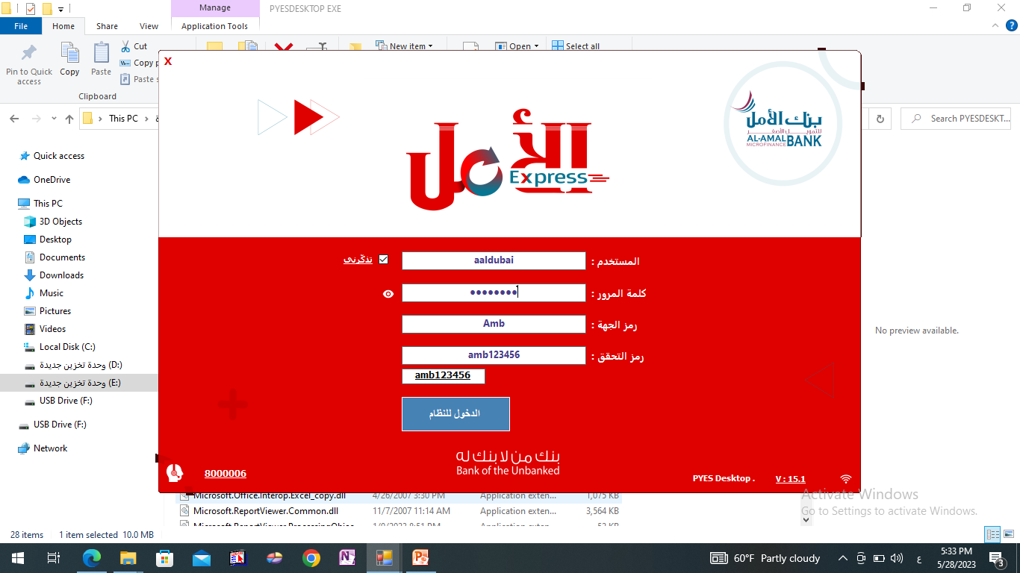
System login screen
After ensuring that the device is connected to the Internet, click on the system icon to open the system login screen to enter user data
User name
Password
Agent code
Verification code: Write the number added in the box below
Click on the login button
التاكد من رقم اصدارالنظام

Slide 4
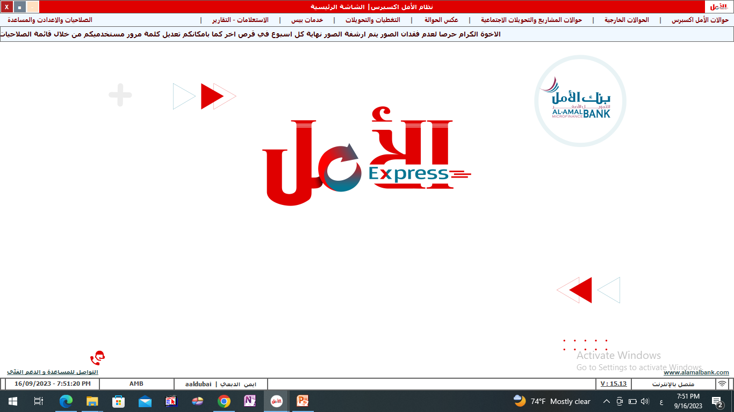
Main Screen
After logging into the system, you will be taken to the
main screen to view Services provided by the system

Slide 5
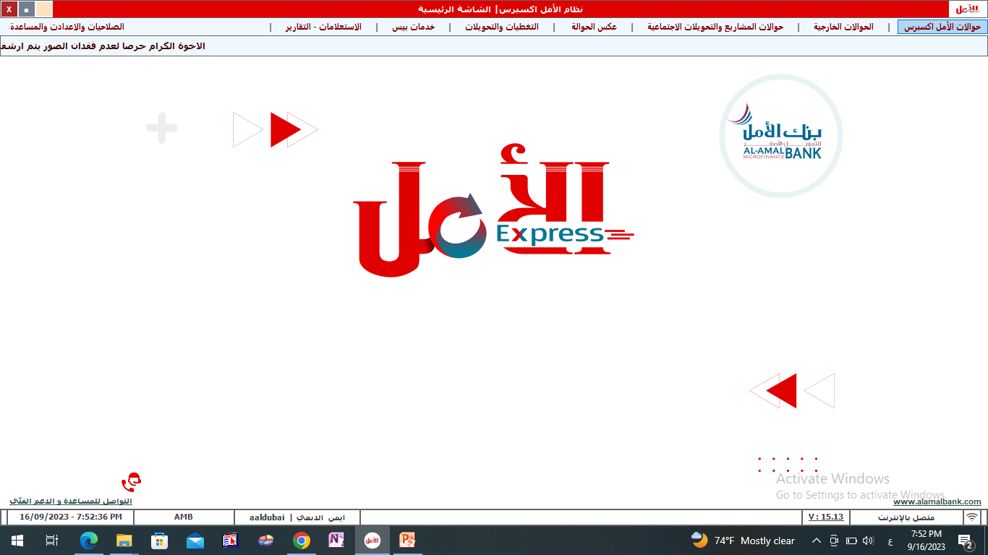
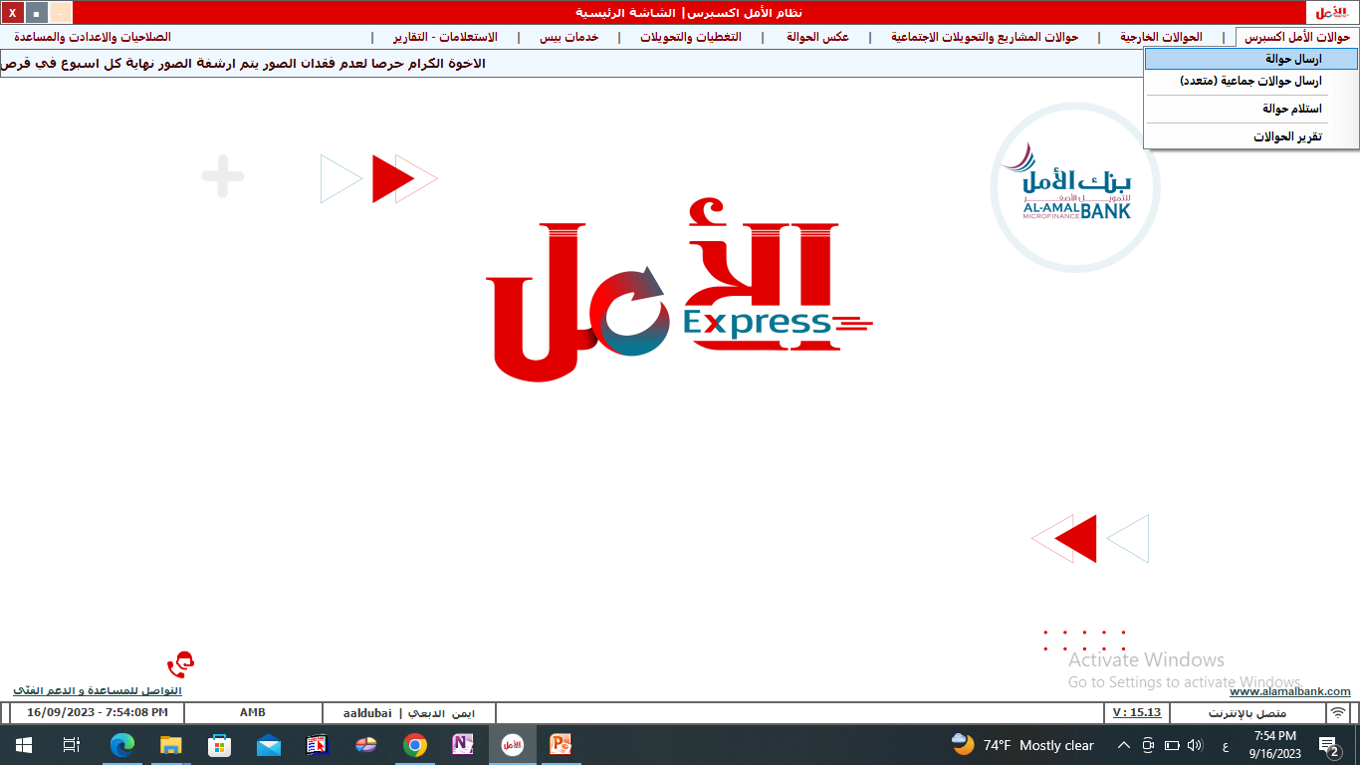
Al Amal Express transfer screens

Slide 6

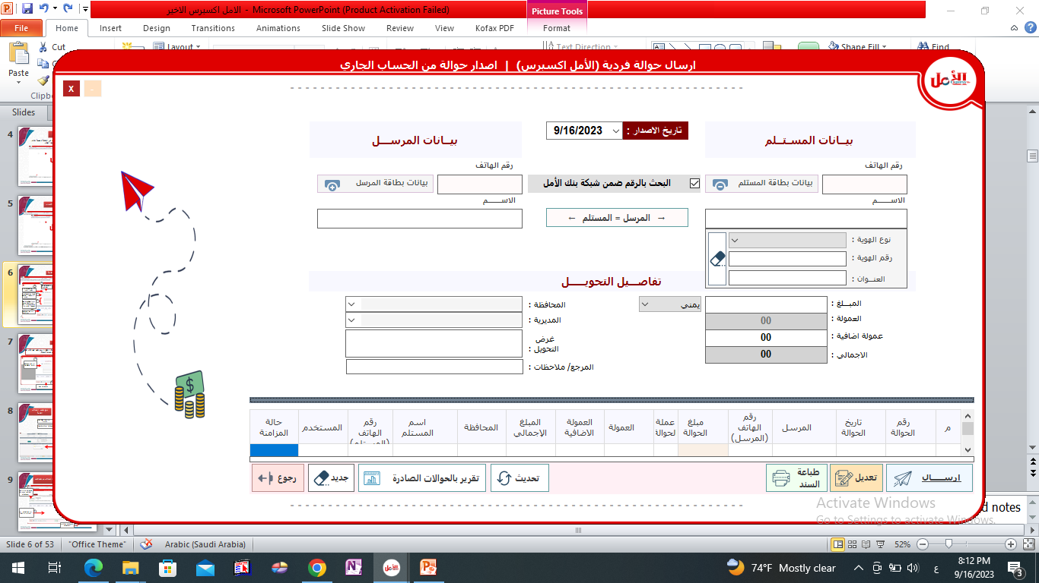
First: Sending Al-Amal Express transfers
6
2
1
Click on the recipient's card information button
The recipient's data is filled in (phone number, name)
5
Click on the sender card data button
The sender's data is filled in (phone number, name)
3
To add the rest of the recipient data (card type, card number, address)
To add the rest of the sender’s data (card type, card number, address)
7
4
Fill out the transfer details (enter the governorate, directorate,...)
8
Fill in the transfer details (amount, specify the currency, the calculated commission is displayed,)
Fill out the transfer details (enter the governorate, directorate,...)
9
Click on the Send button to send the transfer

Slide 7
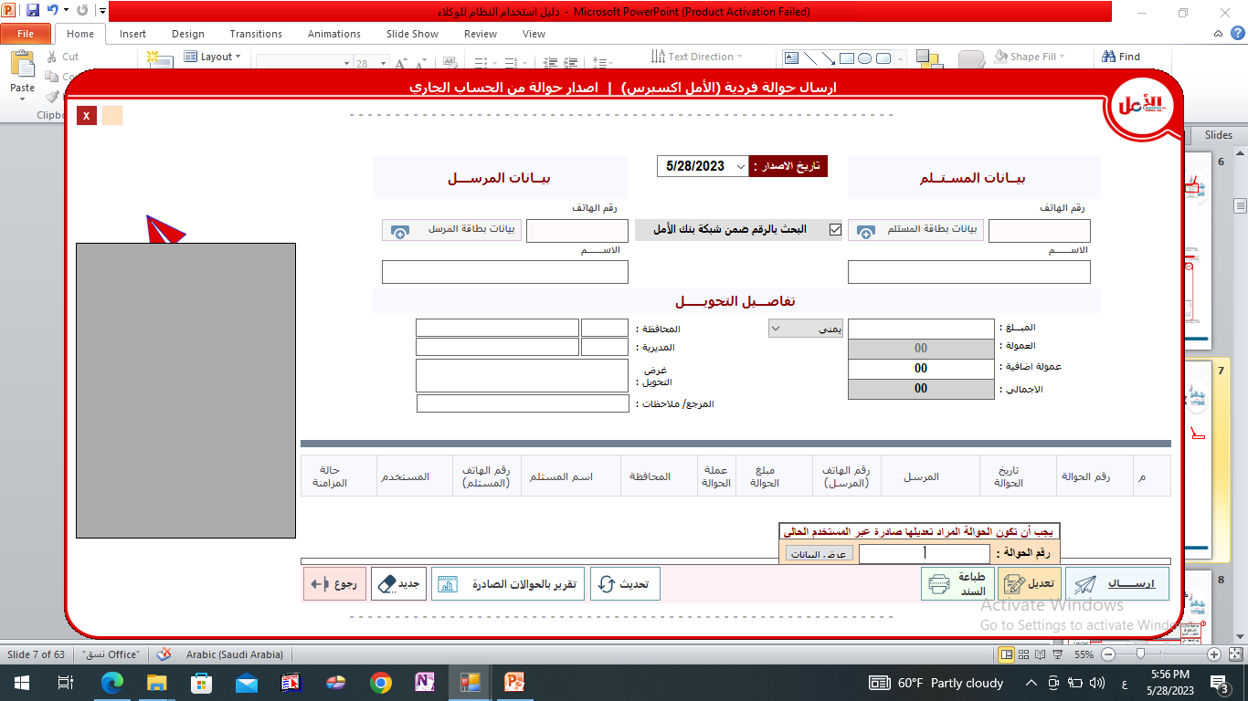
Modifying Al-Amal Express transfers
In order to modify Amal Express transfers, it is required that they be ready for payment and that the transfer be modified by the same user who disbursed the transfer.
4
5
The transfer data that was clicked to edit is displayed
Edit the recipient's name
2
Enter the transfer number
6
3
1
Click the save button
Click on the View Transfer Data button
Click on the Edit button

Slide 8
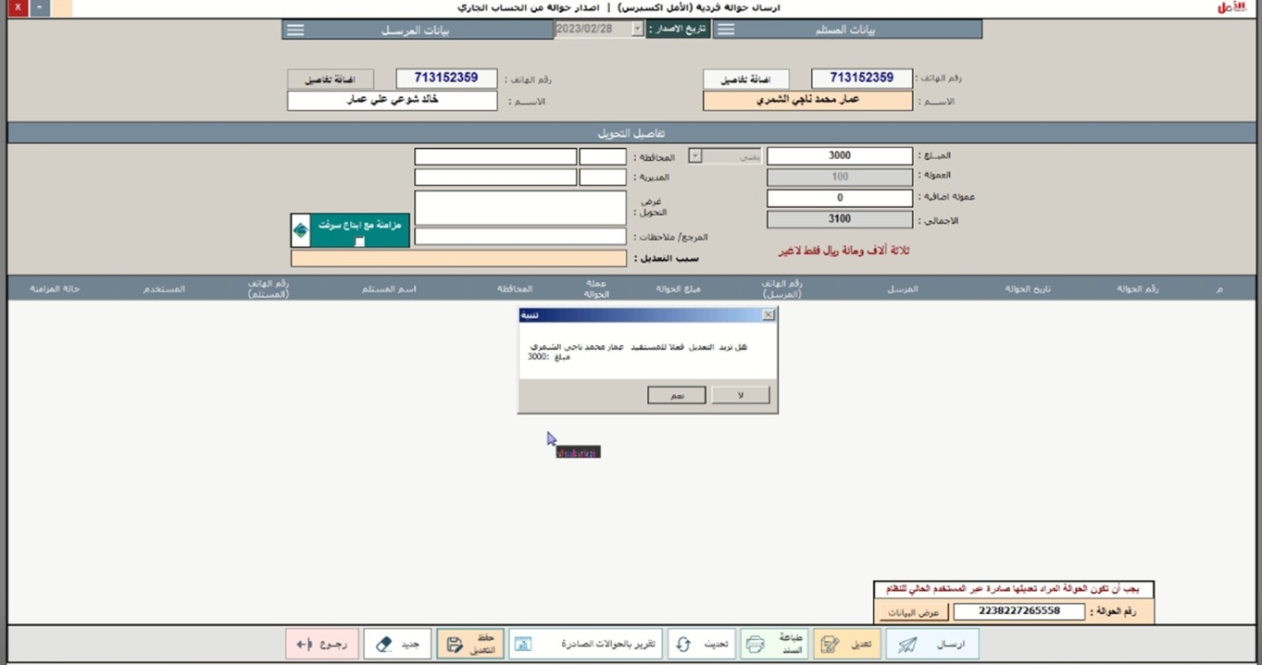
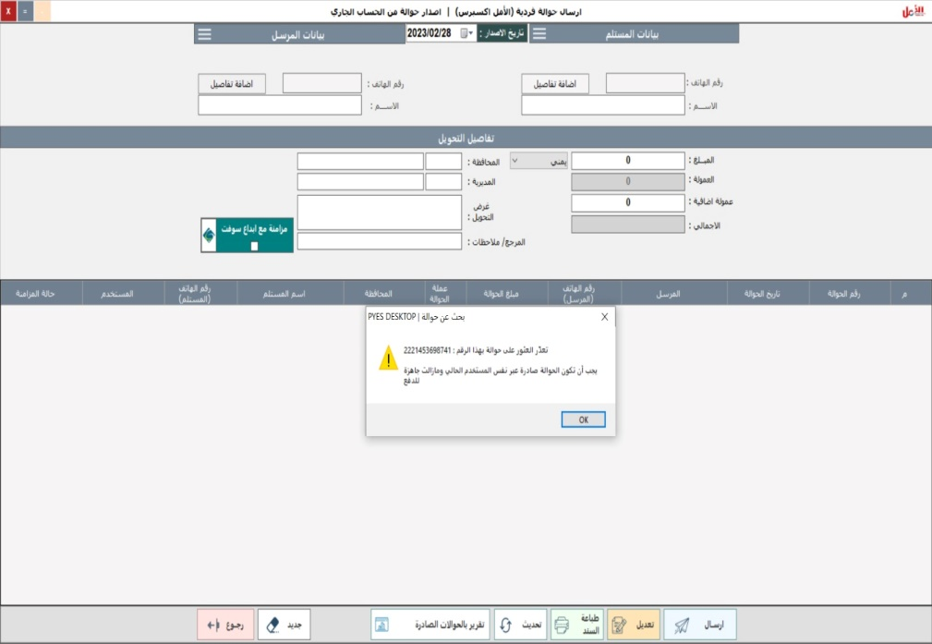
Follow the amendment of Al-Amal Express transfers
A message confirming the modification is displayed
7
8
Click the Yes button to make the modification
The warning message is displayed if the conditions for amending the transfer are not met and the amendment is not allowed

Slide 9
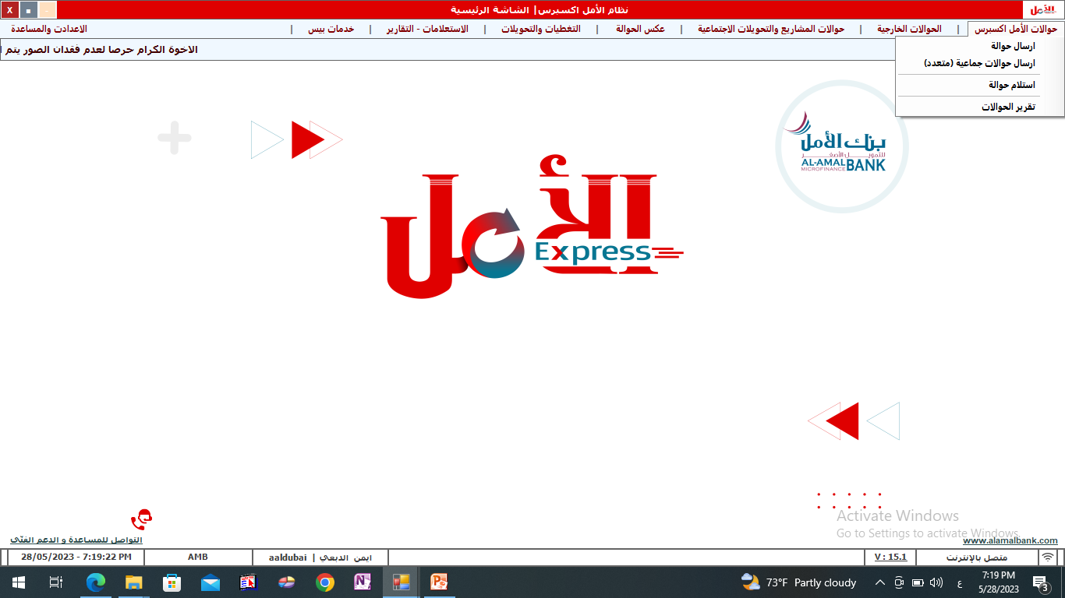
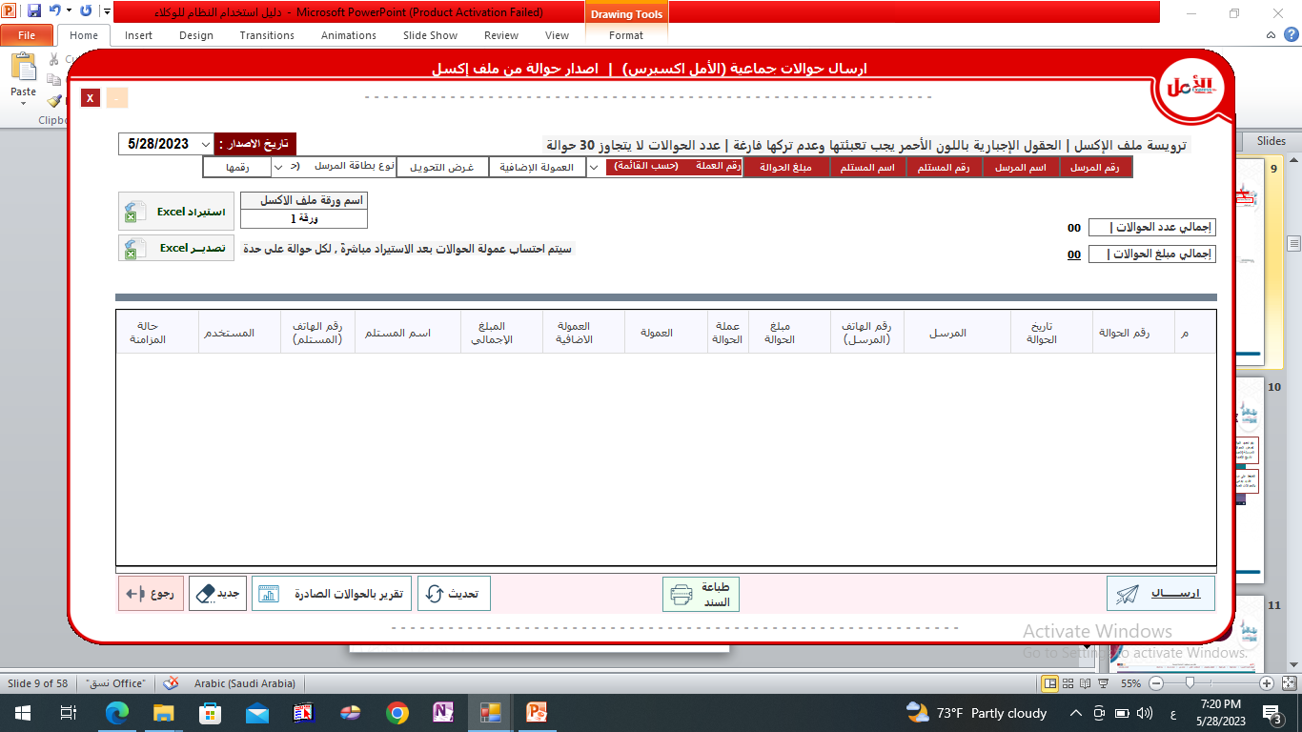
Second: Sending collective transfers (issuing a transfer from an Excel file)
2
Click on the Import Excel file button that contains transfer data
Transfer data must be filled out according to the Excel file header, provided that the number of transfers in the Excel file does not exceed 30 transfers, in addition to the importance of filling out the fields shown in red and not leaving them empty, and keeping the Excel on the disk or desktop.
1
The transfers are displayed after importing from Excel
4
3
Display the total number of transfers The total amount of transfers with commission
Click on the Send button to send the transfers
5

Slide 10
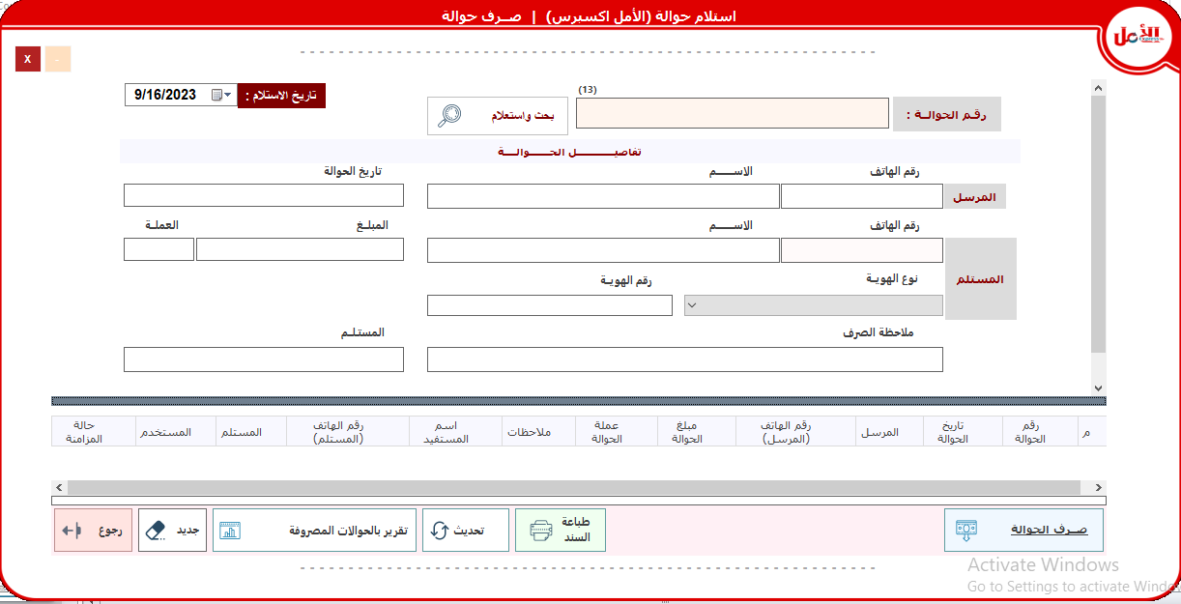
Third: Receiving Al Amal Express transfers
2
1
Enter recipient data
Click on the Search and Inquire button
3
View sender data
Enter recipient data
4
6
5
Click on the Print Instrument button
Click on the transfer button

Slide 11
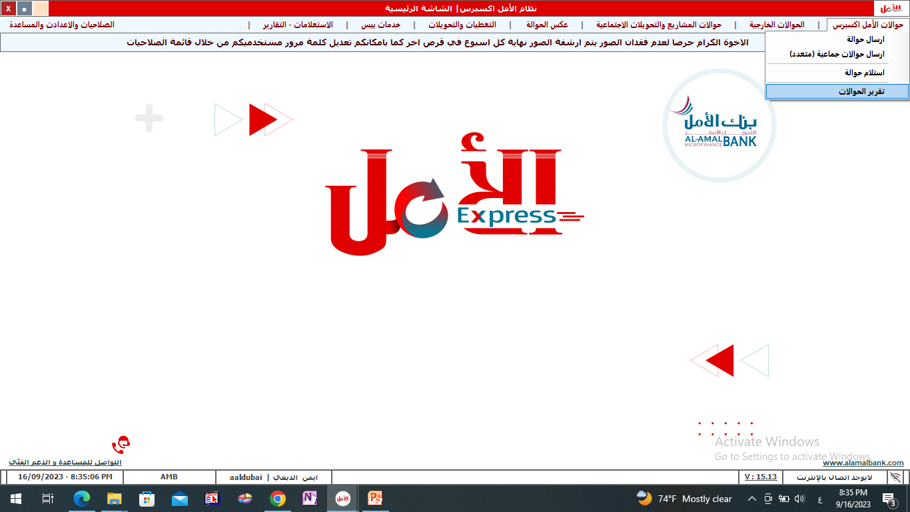
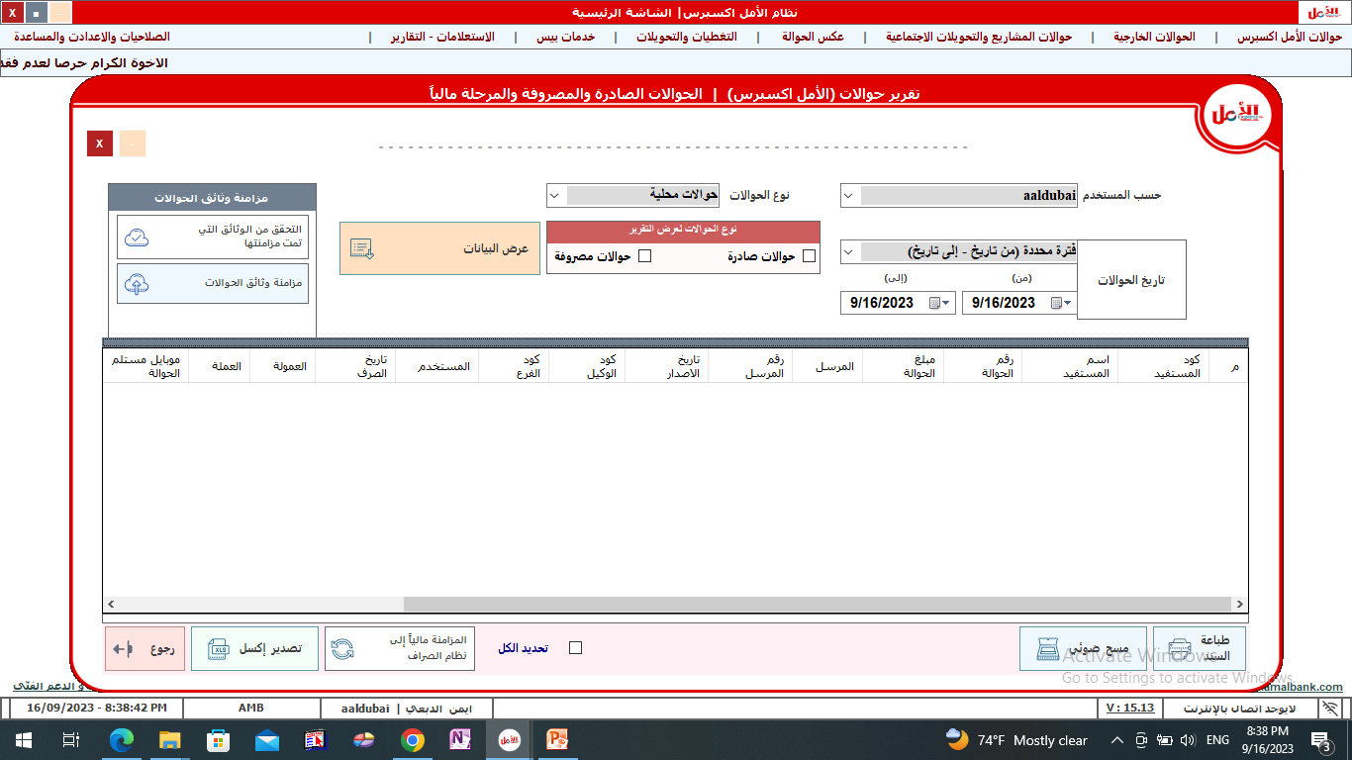
Fourth: Al-Amal Express transfer report
Determine the type of transfers, local or external transfers
3
2
User choice
1
Determine the type of report: outgoing transfers or disbursed transfers
4
Select from date to date
Click on the View Data button
5
Displays all transfers
Click on the Print Instrument button
6
Click on the Export Excel button for the report
Select the transfers and press the Sync button to the ATM system

Slide 12
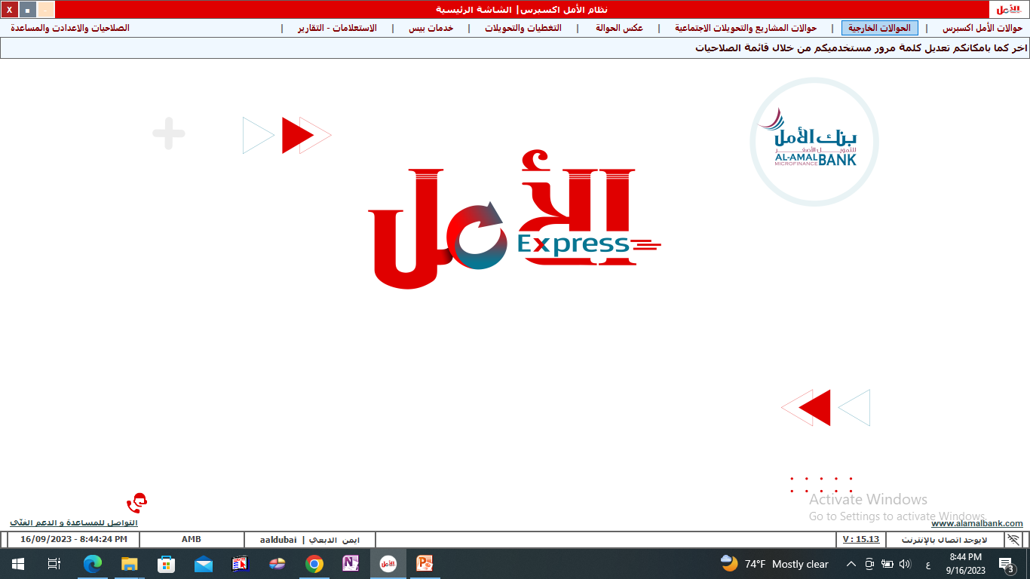
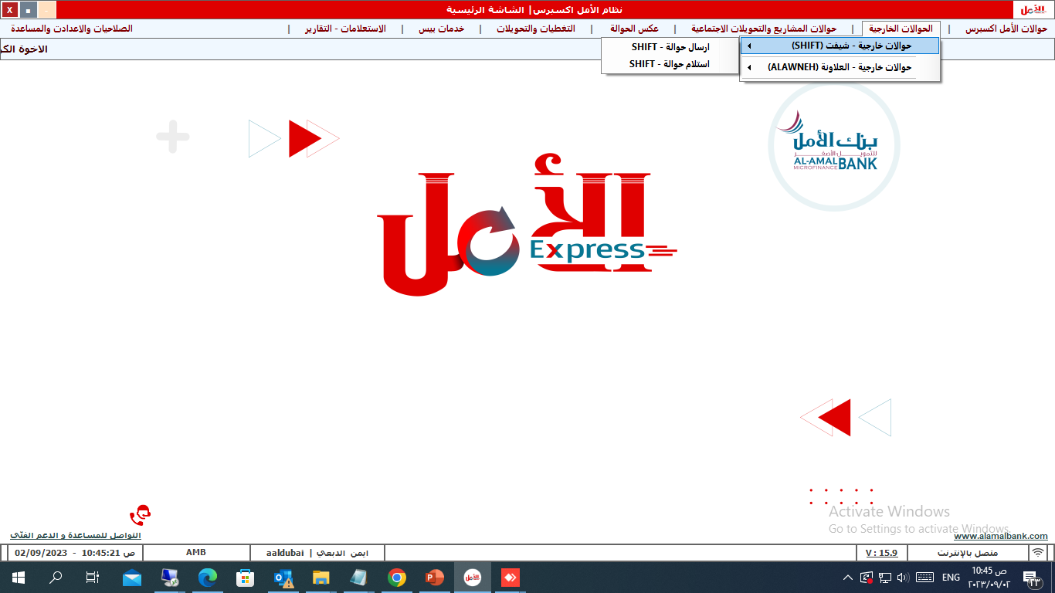
External transfers shifted

Slide 13
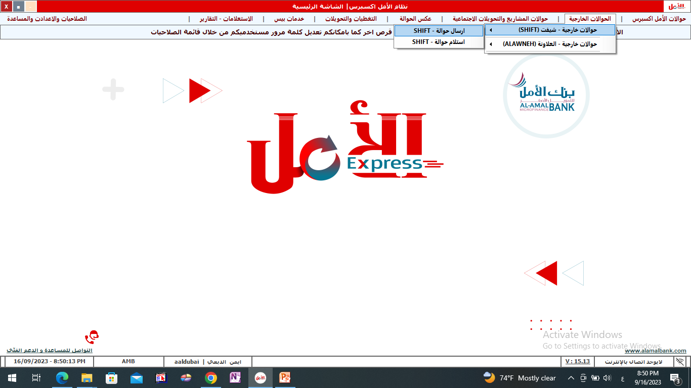
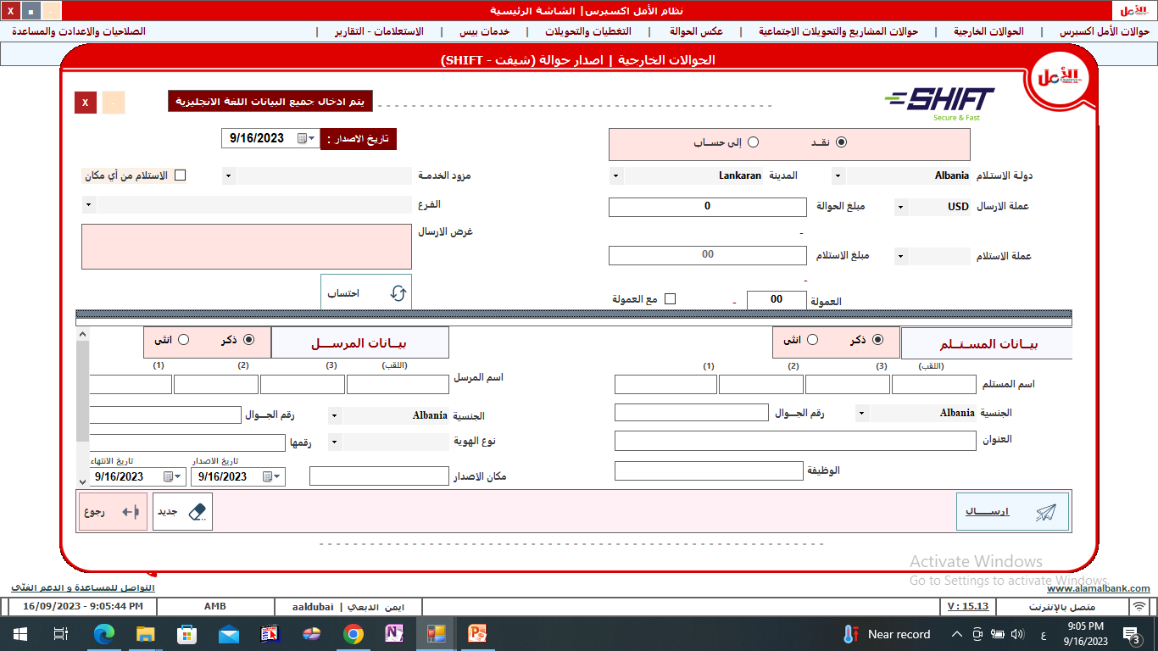
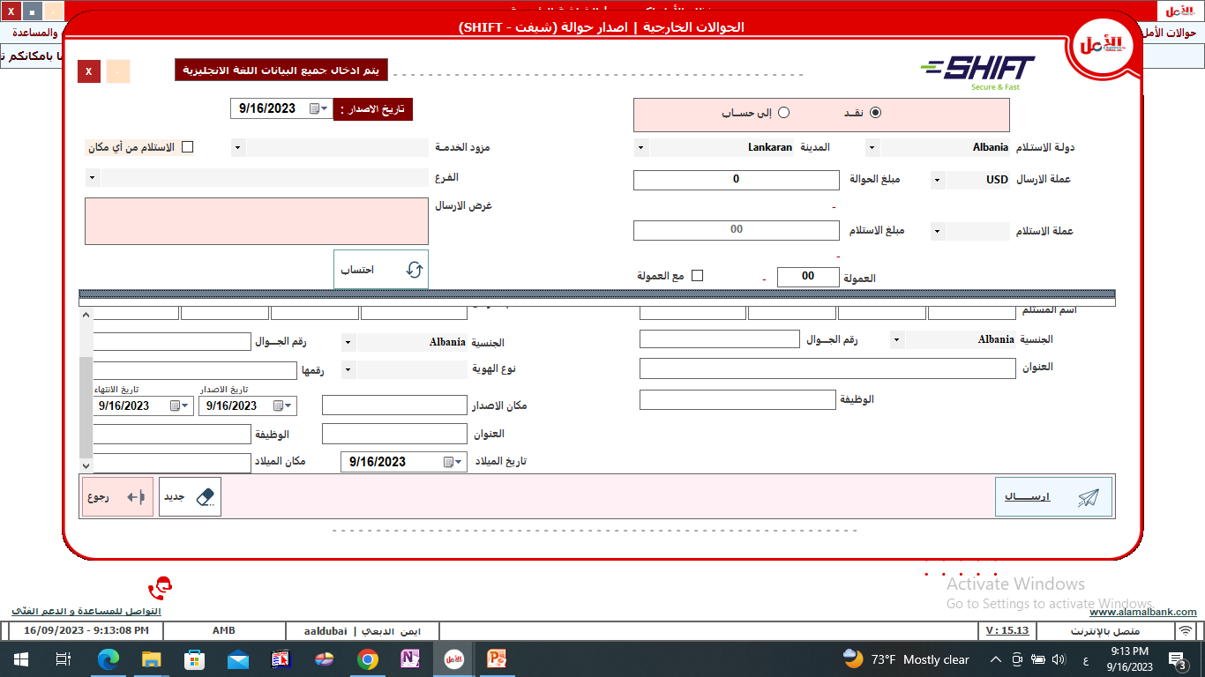
First: Sending external transfers (sending shift transfers
Click on the arrow to choose the service provider
6
Choose the type of service
1
2
Click on the arrow to select the branch
Choose city
3
Click on the arrow to choose the recipient's country
7
5
Enter the transfer amount
Purpose of conversion
8
4
Commission is fetched
Currency calculation
Enter the name sender
10
Specify the receiving currency
9
Determine gender
Enter the recipient's name
Mobile number
Determine nationality
Determine nationality
ID type and number, date of issue and place of issue
Mobile number
Enter the address
Enter the address
Define the job
Specify the date, place and place of birth
Define the job
11
Click on the Send Transfer button

Slide 14

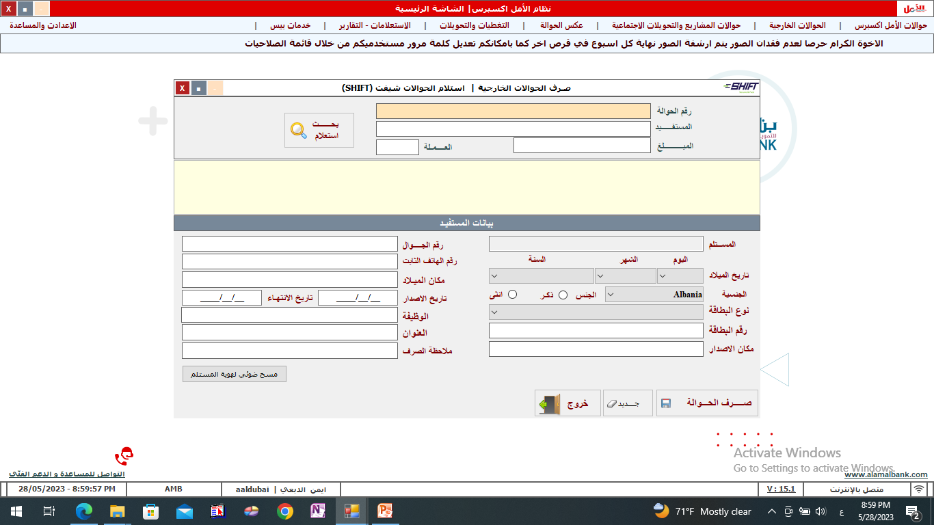
Second: Receiving external transfers (receiving shift transfers
1
2
Enter transfer data Number of remittance voucher beneficiary the amount
Click on the Search and Inquire button
Enter beneficiary data Telephone numbers place of birth Card issuance and expiry date Function the address Exchange note
3
Enter beneficiary data The recipient's name Determine nationality Type of card number place of issue
4
5
Click on the transfer button

Slide 15

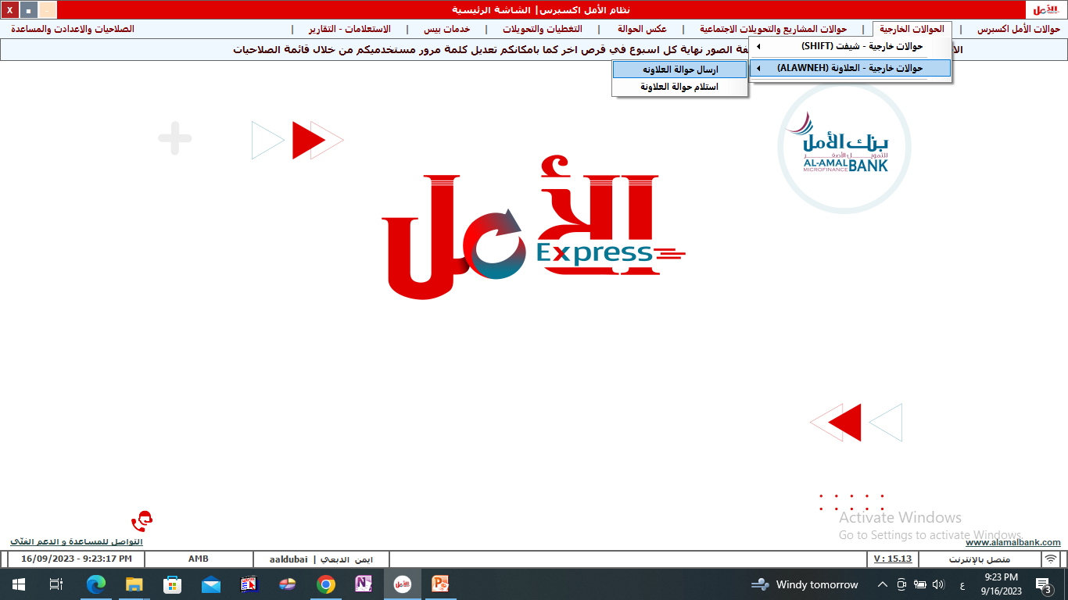
External remittances Aleilawina

Slide 16
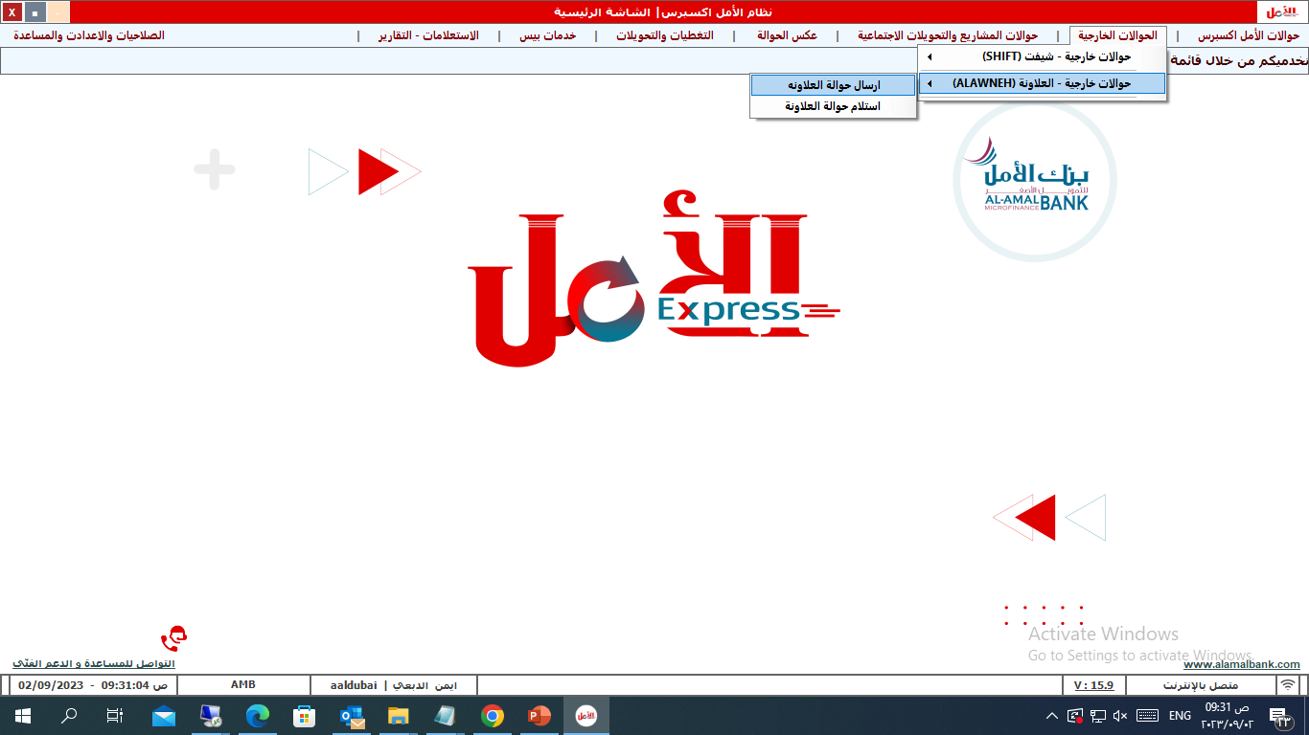
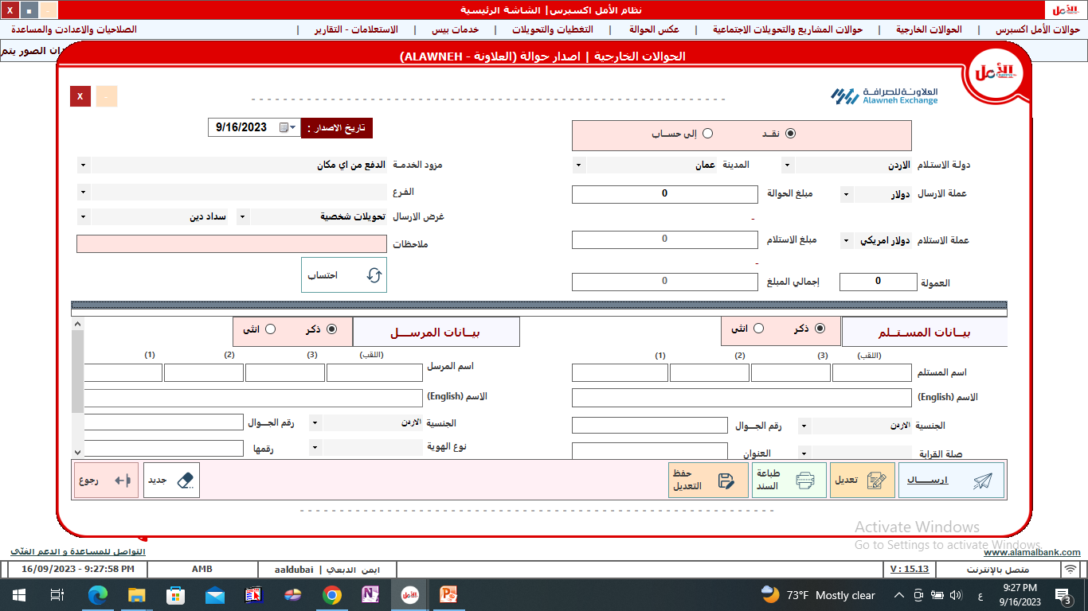
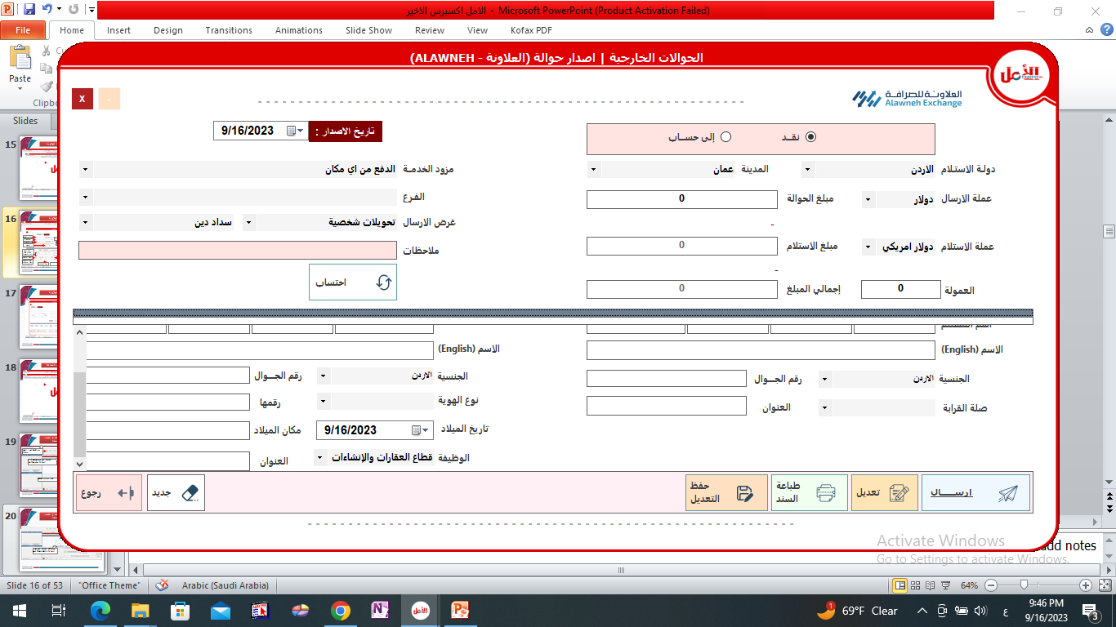
Sending Aleilawina transfers
Select the type of service - cash delivery - deposit to an account
1
Select the service provider
8
2
Select the receiving country
4
Select the branch
9
Select city
3
Transfer amount
6
Select the sending currency
Purpose of conversion
10
7
5
Calculation
Receipt amount
Select a currency The receipt
Enter the recipient's data in Arabic and English
12
Select a data type (recipient-sender)
11
Enter the recipient's data in Arabic and English
Enter the mobile number
Select the gender
Select the gender
Select the ID type Enter the ID number
Enter the address
Enter the mobile number
Determine kinship
Enter date and place of birth
Enter the sender's address
Select the job
Click on the Send Transfer button
13

Slide 17
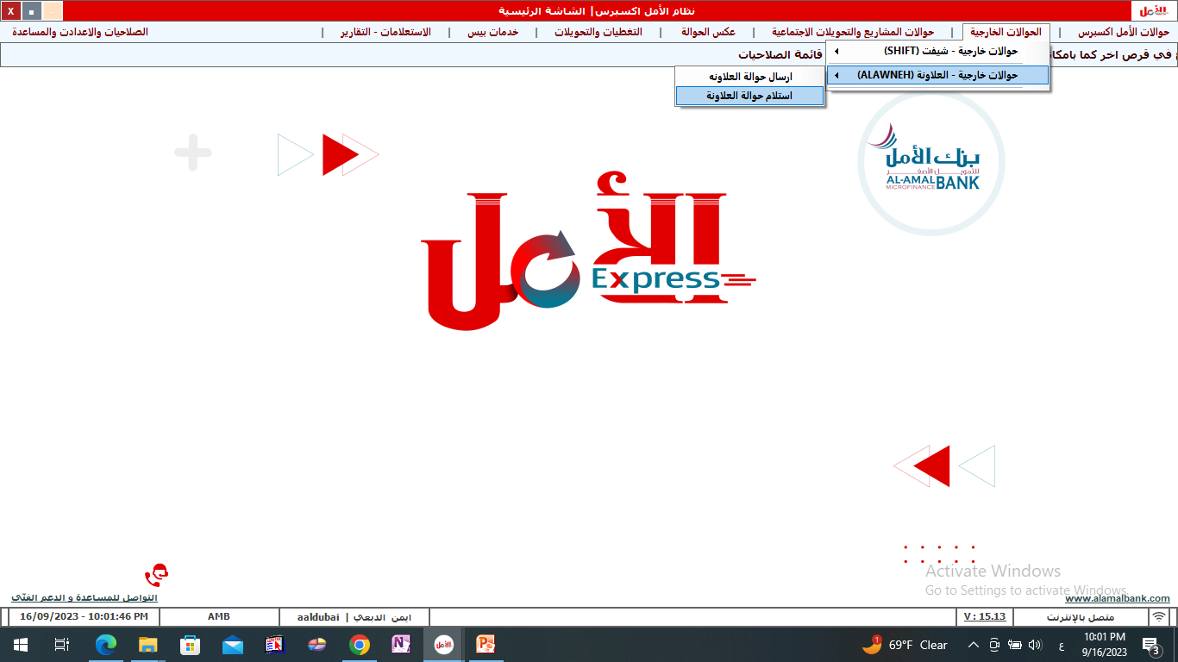
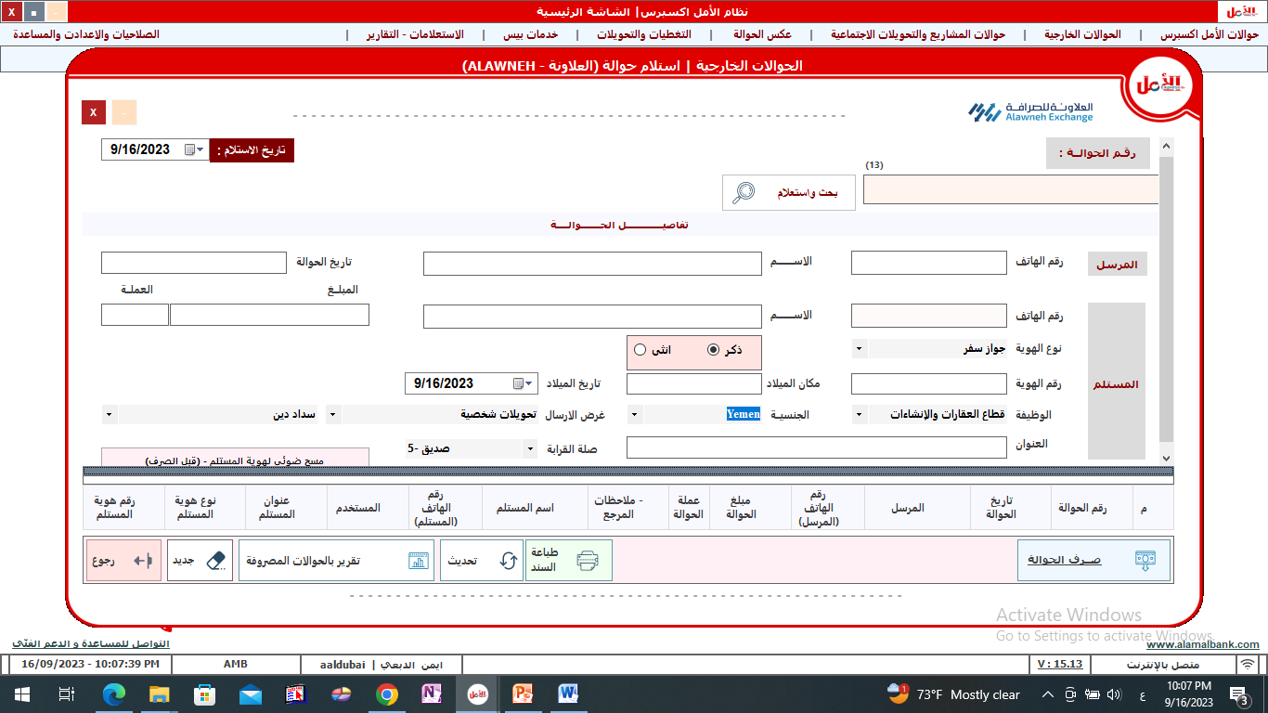
Receiving Aleilawina transfers
Click on search and query button
Enter the transfer number
1
2
The transfer data will be displayed
3
4
Select the ID type
Enter place of birth
6
Enter date of birth
5
Select the ID type
7
8
Enter the address
Click on the transfer button
9

Slide 18
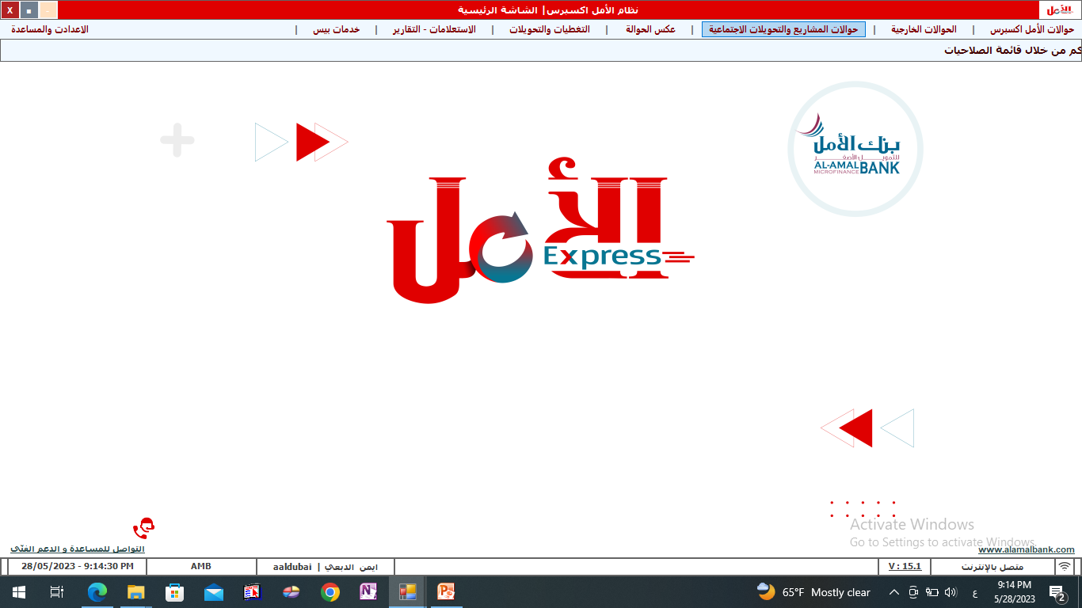
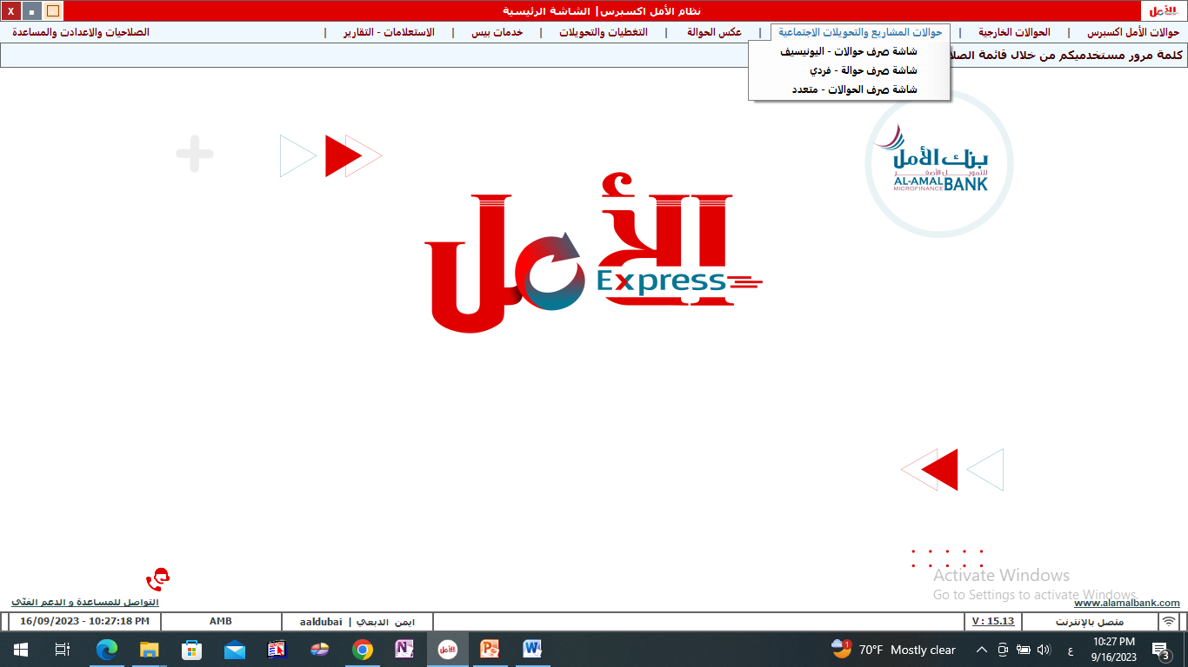
Project transfers and social transfers

Slide 19
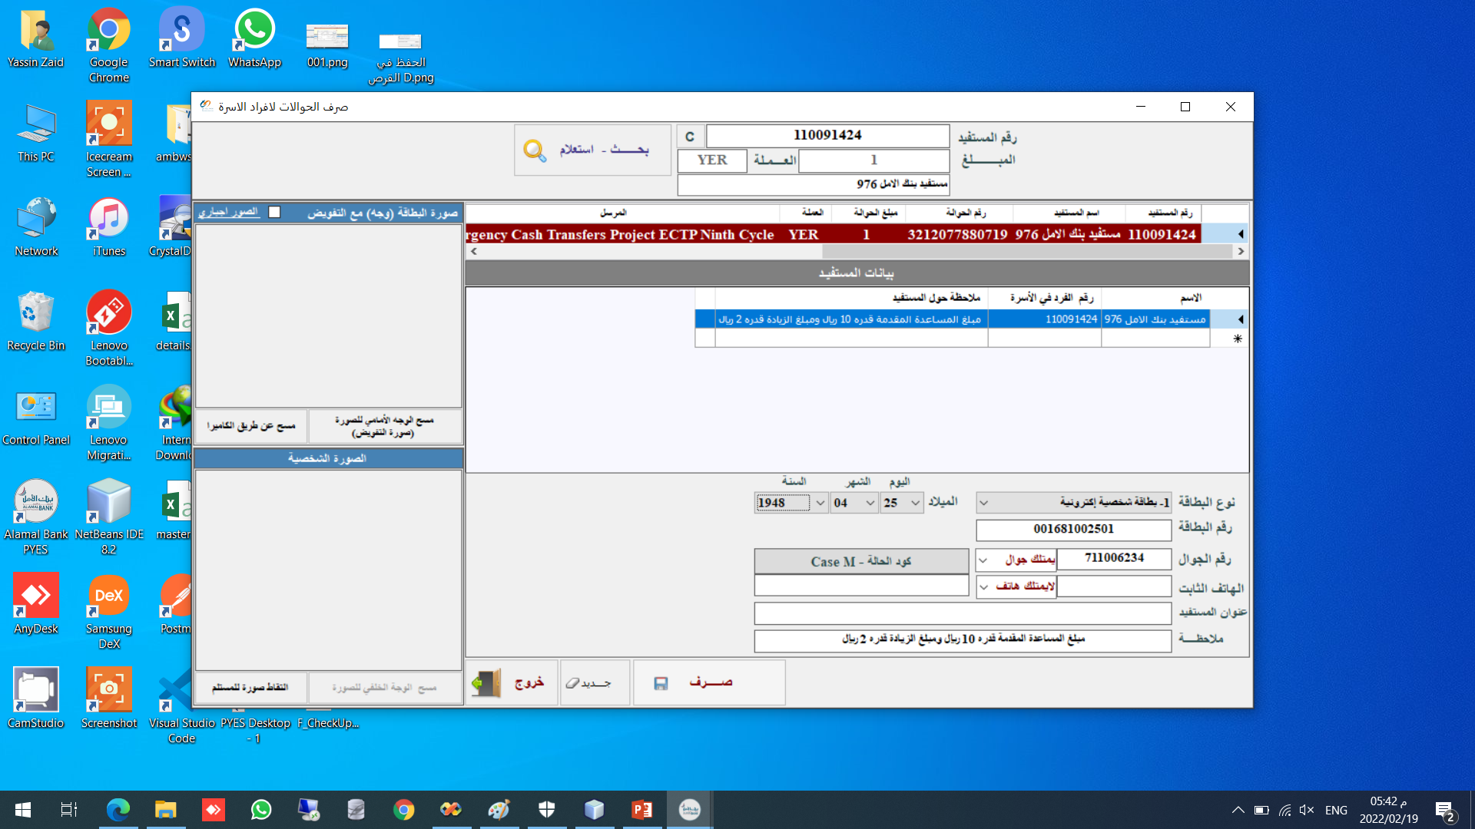
First: The mechanism for disbursing the transfer to the Social Security Project (UNICEF)
1
2
The beneficiary number or transfer number is entered
Click on search and query button
Click on the name of the beneficiary or the trans number with the red bar
3
4
Complete the beneficiary information
Click on the transfer button

Slide 20
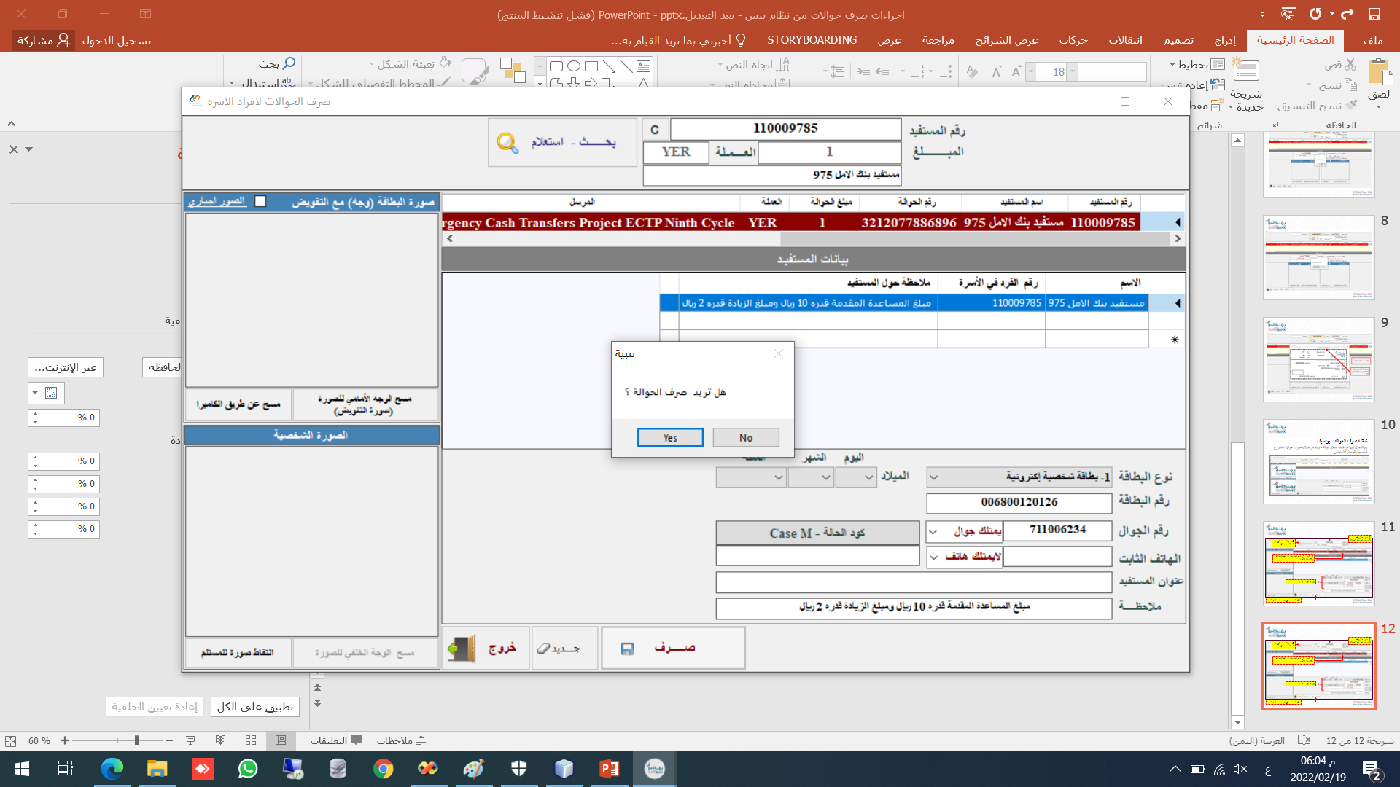
Follows the transfer disbursement mechanism for the Social Security Project (UNICEF)
6
Click on the YES button to disburse the transfer and proceed to printing the bond

Slide 21
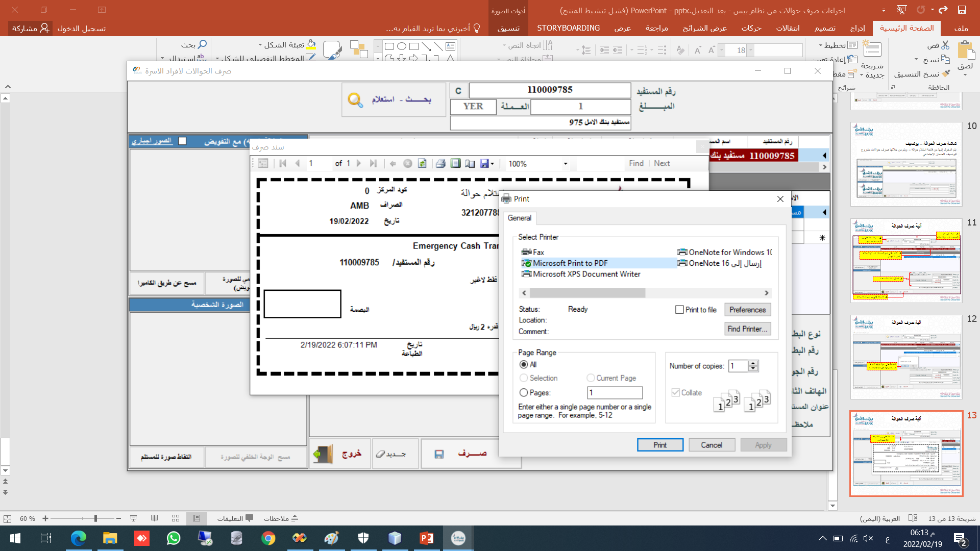
Follows the transfer disbursement mechanism for the Social Security Project (UNICEF)
7
Click on the printer icon
8
After click the print button ,a screen appears to select and choose the printer
The number of copies the document to be printed is determined and signed the beneficiary one for the agent and the second for delivery for the beneficiary
2
9
click the Print button

Slide 22
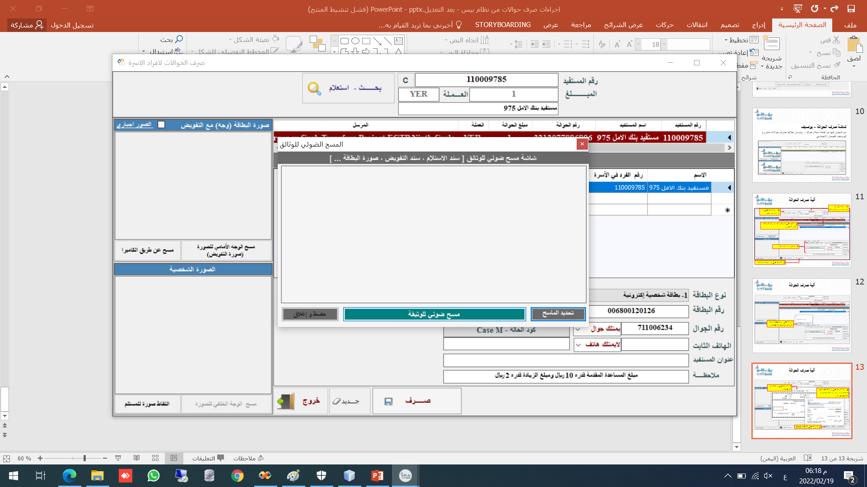
Follows the transfer disbursement mechanism for the Social Security Project (UNICEF)
After printing the bond ,the scanner screen appears to archive the bond after taking the beneficiary's fingerprint on the bond
10
Click on the scan document button ,after placing the document on the scanner

Slide 23
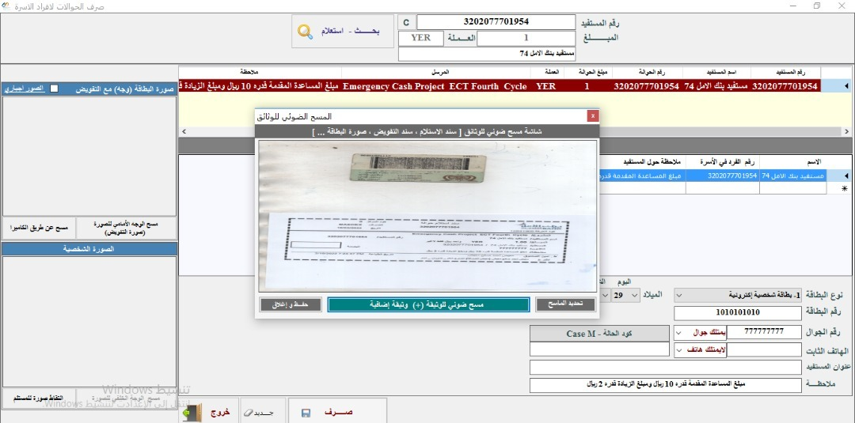
Follows the transfer disbursement mechanism for the Social Security Project (UNICEF)
11
Click on Save and Close to finish archiving and close the screen
You can press the delete button again, if there is another document to be archived

Slide 24
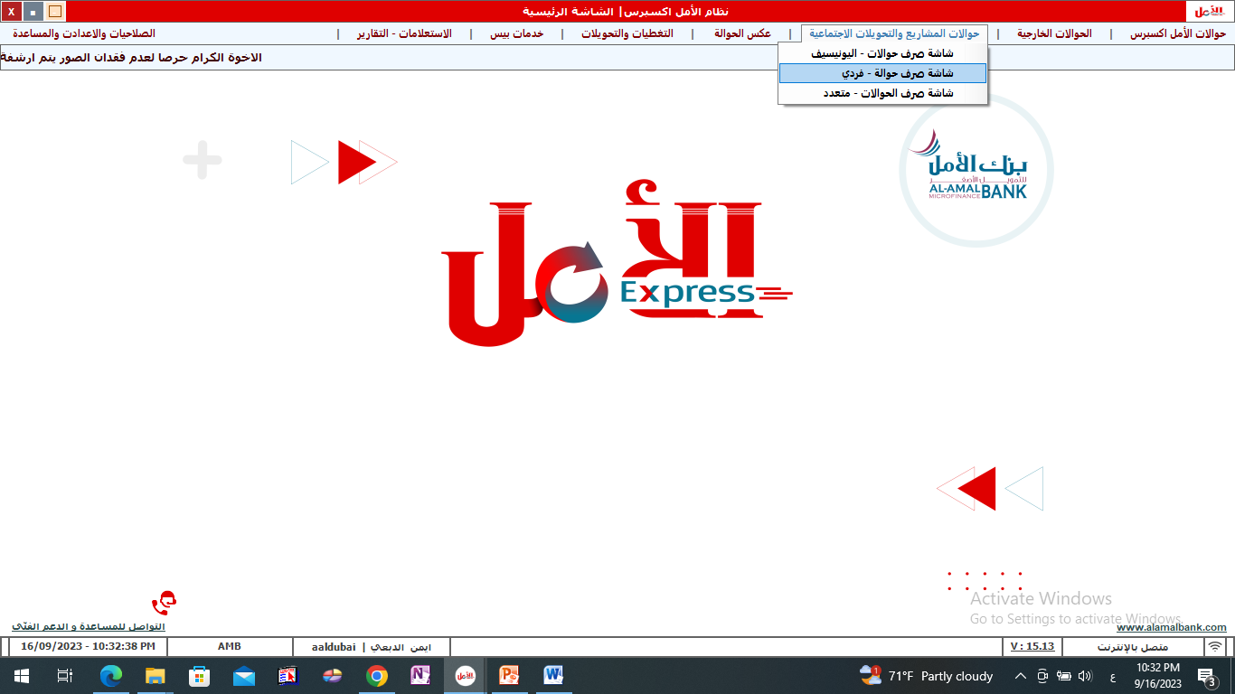
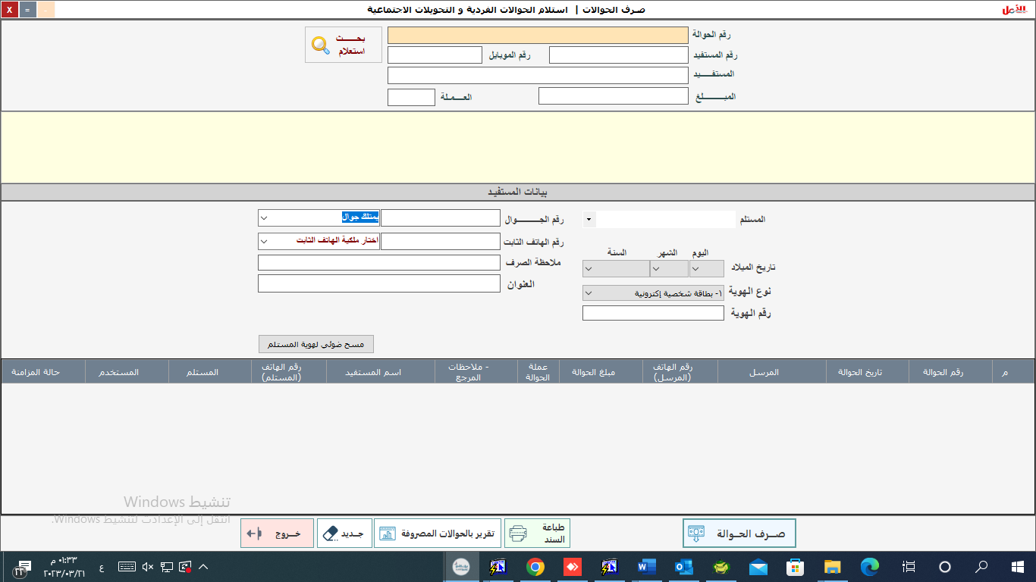
Second: The mechanism for disbursing individual transfers and social transfers
2
Click on the (Search - Inquiry) button
Enter the transfer number
1
5
3
Enter the recipient's name
Enter the mobile number
4
Enter the address
6
Select the ID type and enter the ID number
7
Click on the transfer button

Slide 25

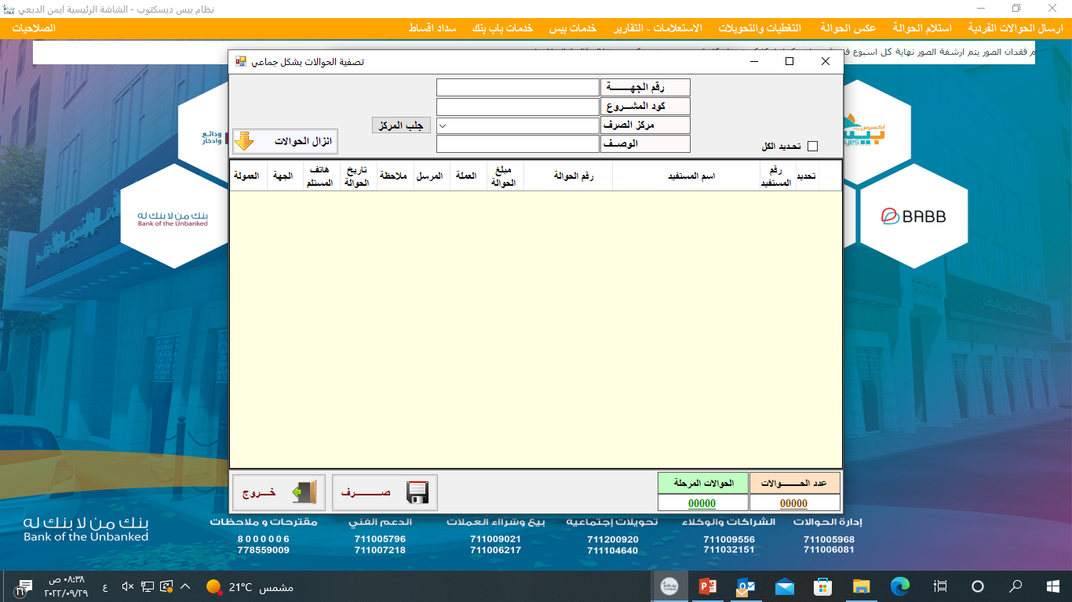
Third: Disbursement of collective transfers
click on the Fetch Exchange Center button and choose the center
2
1
Enter data related to the project
3
Click on download transfers
4
All transfers belonging to the selected exchange center will be displayed
Click on transfer button
5

Slide 26

The most prominent differences between individual transfers and project transfers
Project transfers
Al-Amal Express transfers
Start with the number(3).
Number of
remittance
voucher
Start with the number(2).
The length of the
remittance number(13)
The length of the
remittance number(11)
Drainage system
Pay through the bank system only
Disbursement through the bank system or a main agent (manager - Nasser... etc.)
Exchange supports
According to what appears in the system
Electronic ID card or any approved document..
Inhabit the documents
It is mandatory to submit exchange documents
Accommodation is not required (optional)

Slide 27

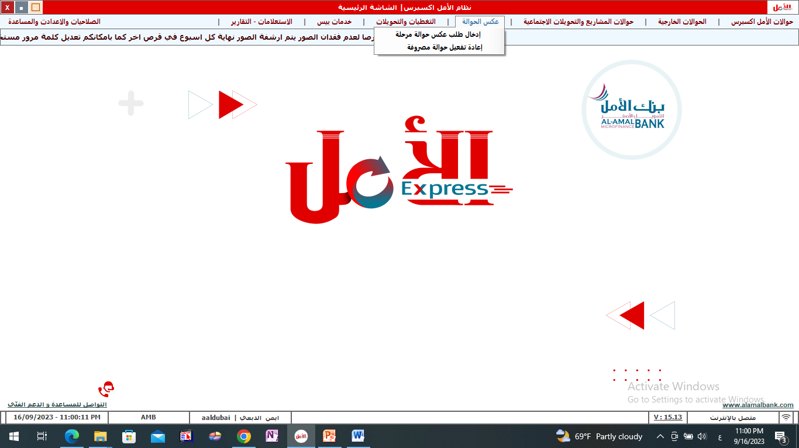
Reverse Transfer

Slide 28
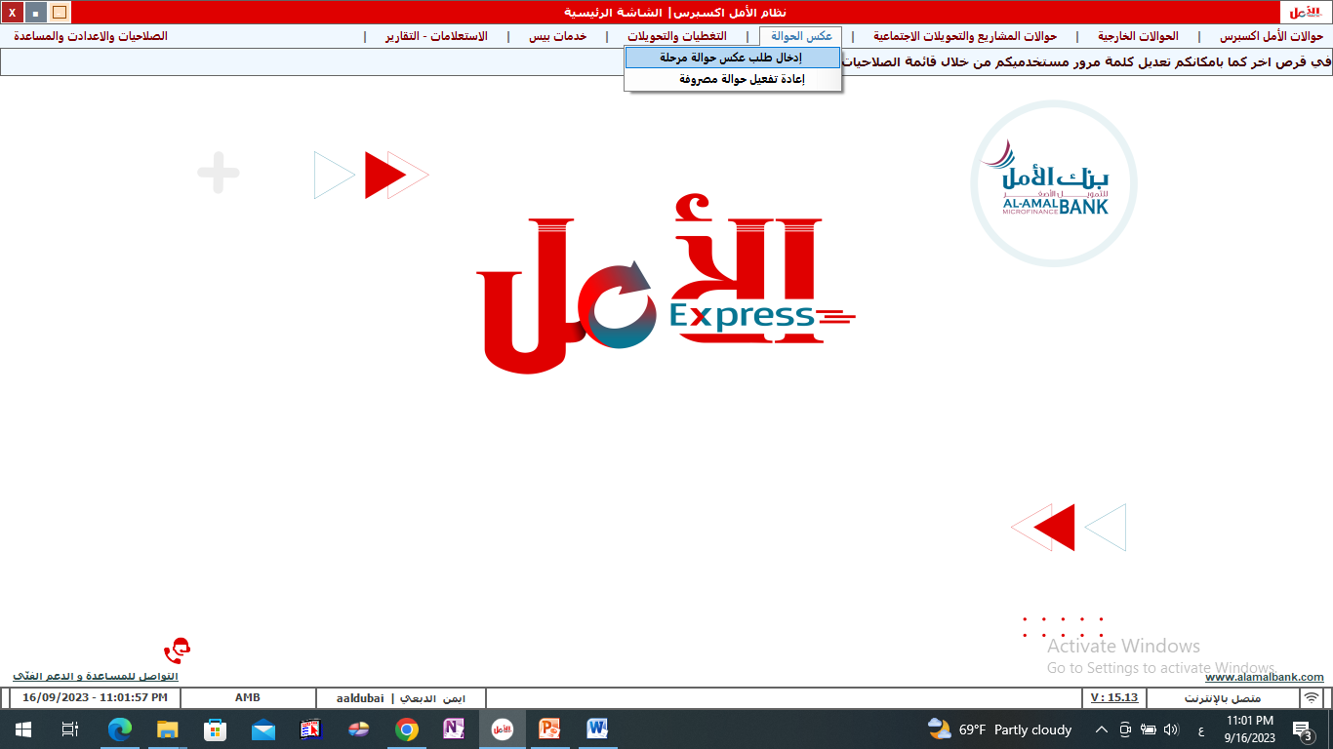
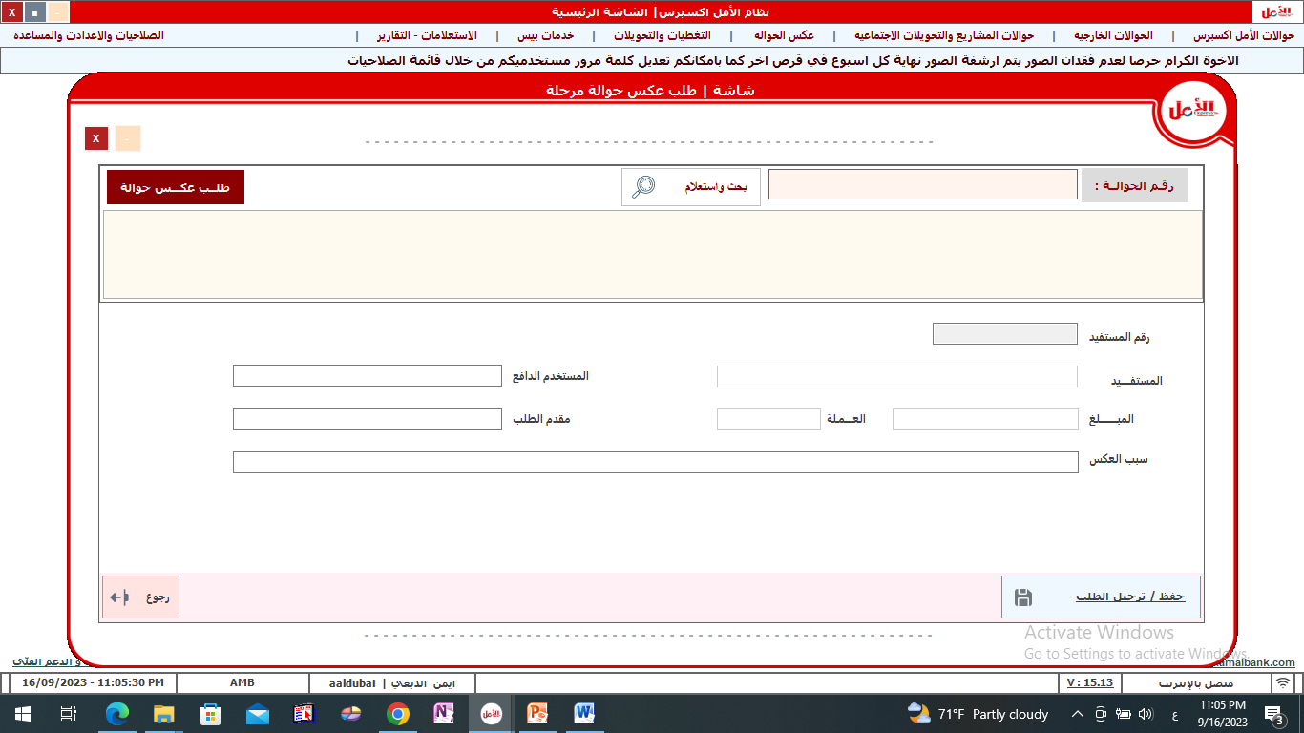
Reverse Transfer
Enter the transfer number
Click on the transfer inquiry button
1
2
Enter the name of the beneficiary
3
Enter the applicant
6
4
5
Enter the amount
Enter the reason for the reversal
7
lick on the Post Request button

Slide 29
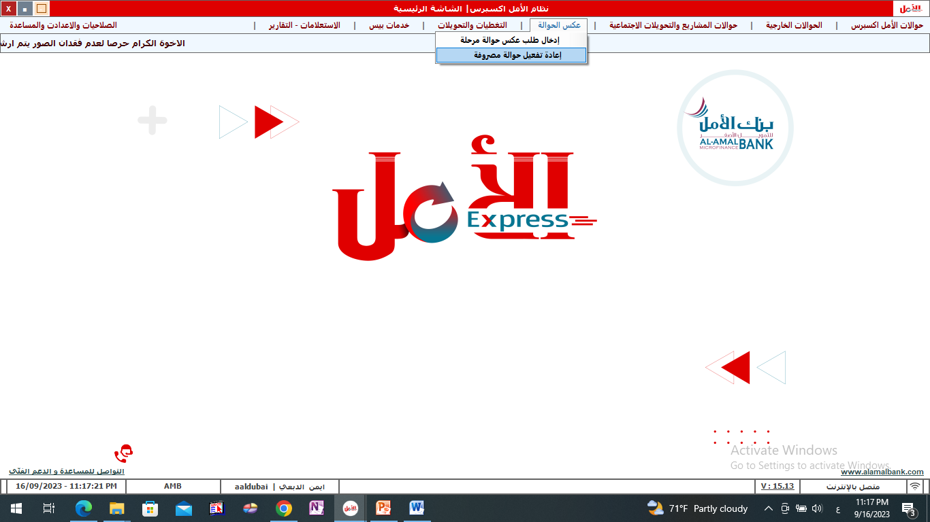
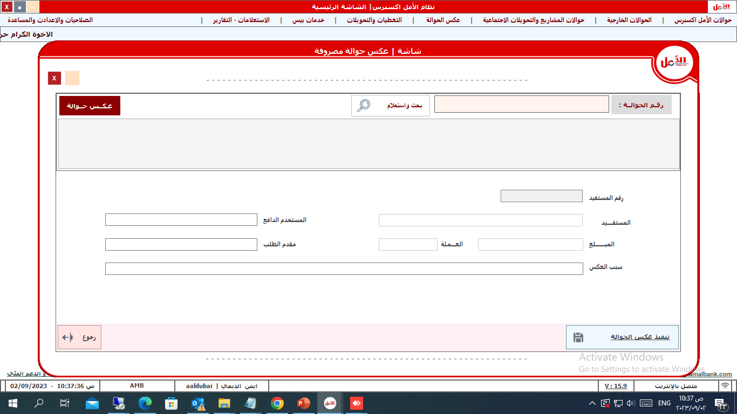
Reactivating a spent transfer
2
1
Click on the transfer inquiry button
Enter the transfer number
3
Enter the name of the beneficiary
Enter the applicant
6
4
Enter the amount
Enter the reason for the reversal
5
7
Click on the Execute Reverse Transfer button

Slide 30
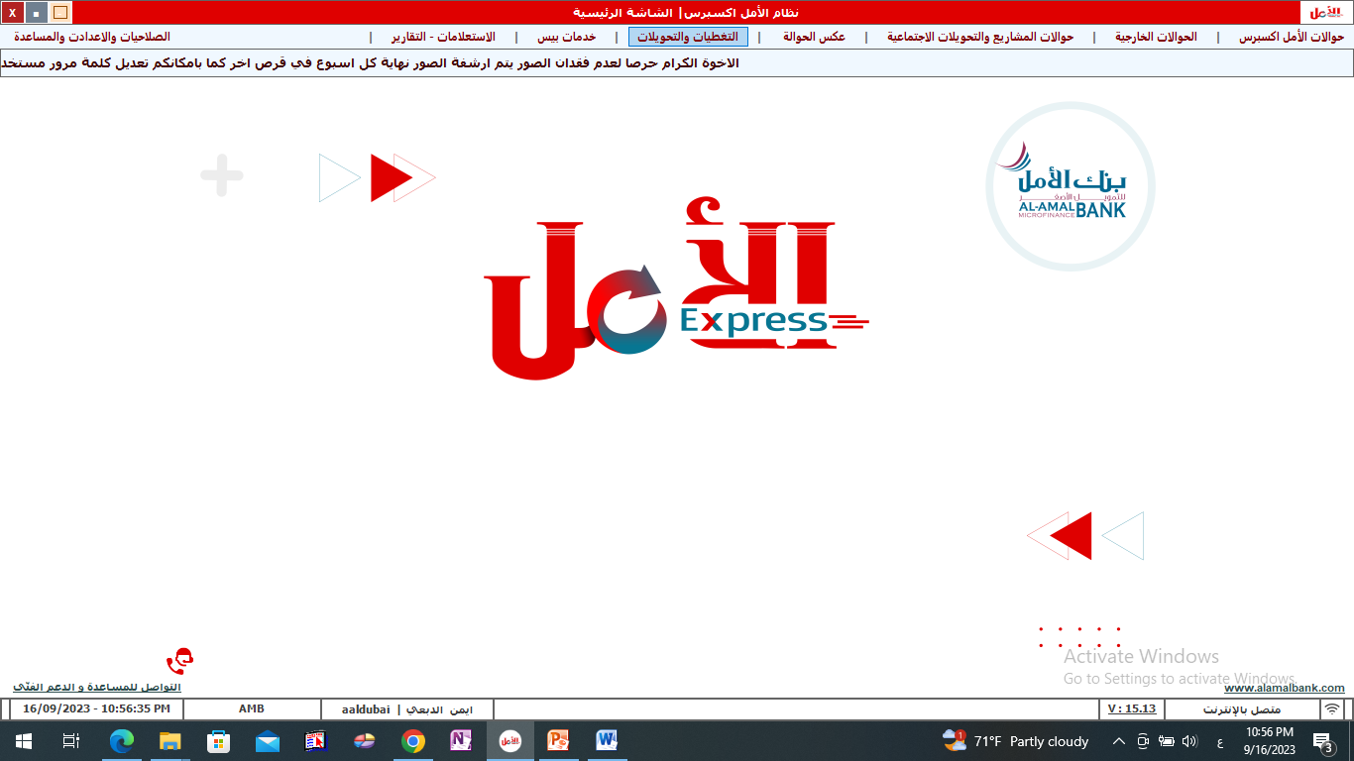
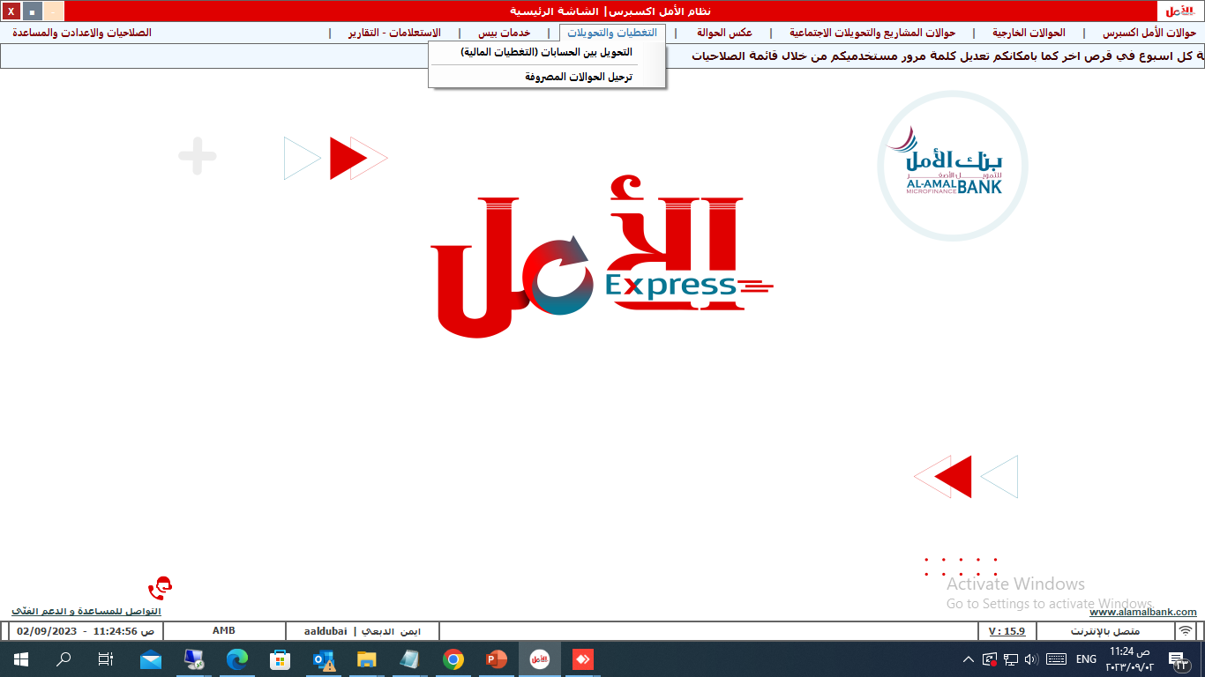
Coverages and transfers

Slide 31
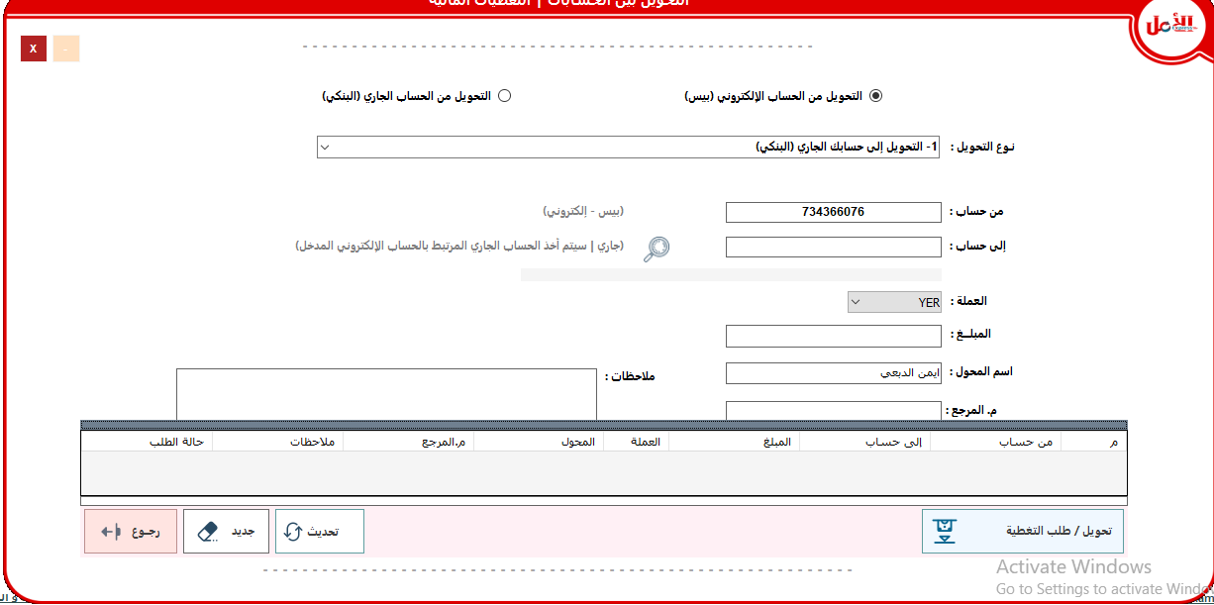
First: Transferring between accounts
Choose the type of transfer based on the previous selection: transfer (either to an electronic or current account) or to another agent’s account
Choose the type of conversion
1
2
3
Enter the account number transferred to the machine
Select the currency
5
4
Enter note
6
Enter the amount adapter name
Click on the Convert button to complete the coverage process
7

Slide 32
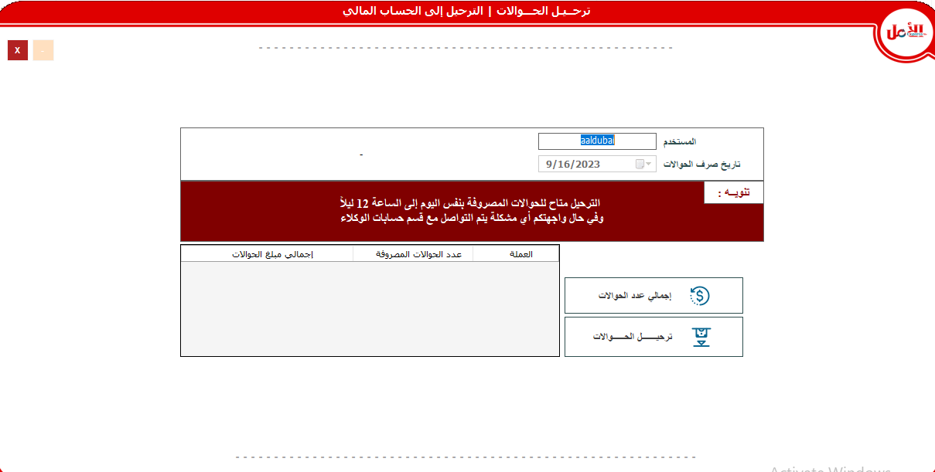
Second: Transferring the disbursed transfers to the financial account
Determine the date of disbursement of transfers
1
Enter username
2
3
The total number of transfers is displayed
4
Click on the Post Remittances button

Slide 33

Pyes service

Slide 34
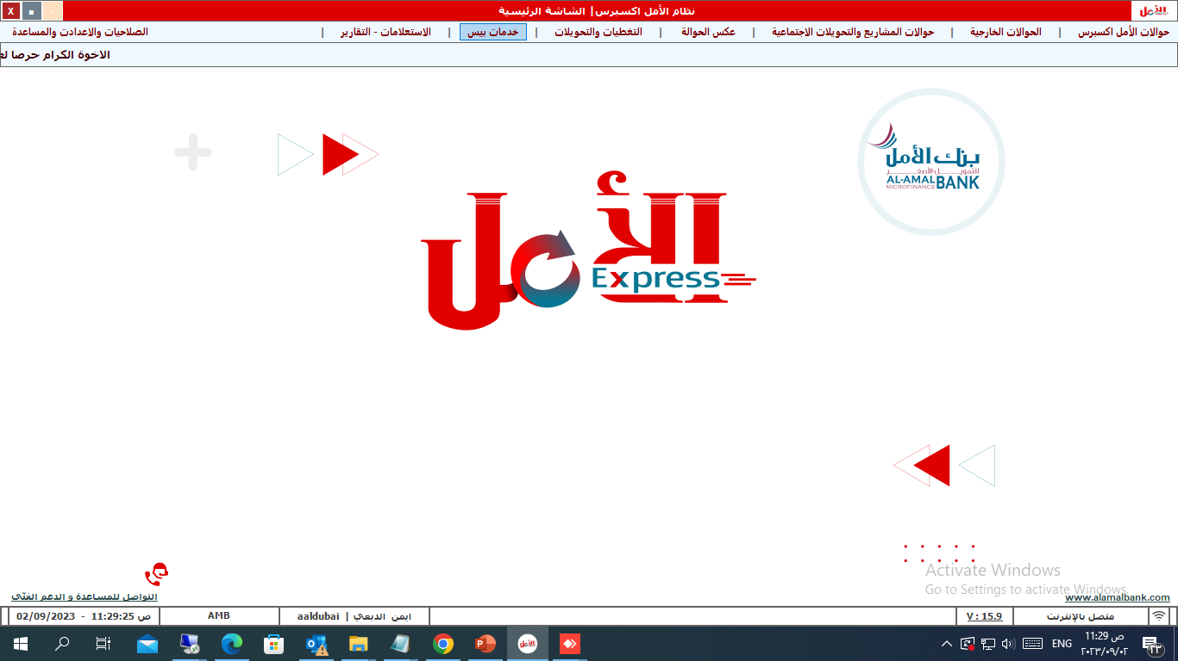
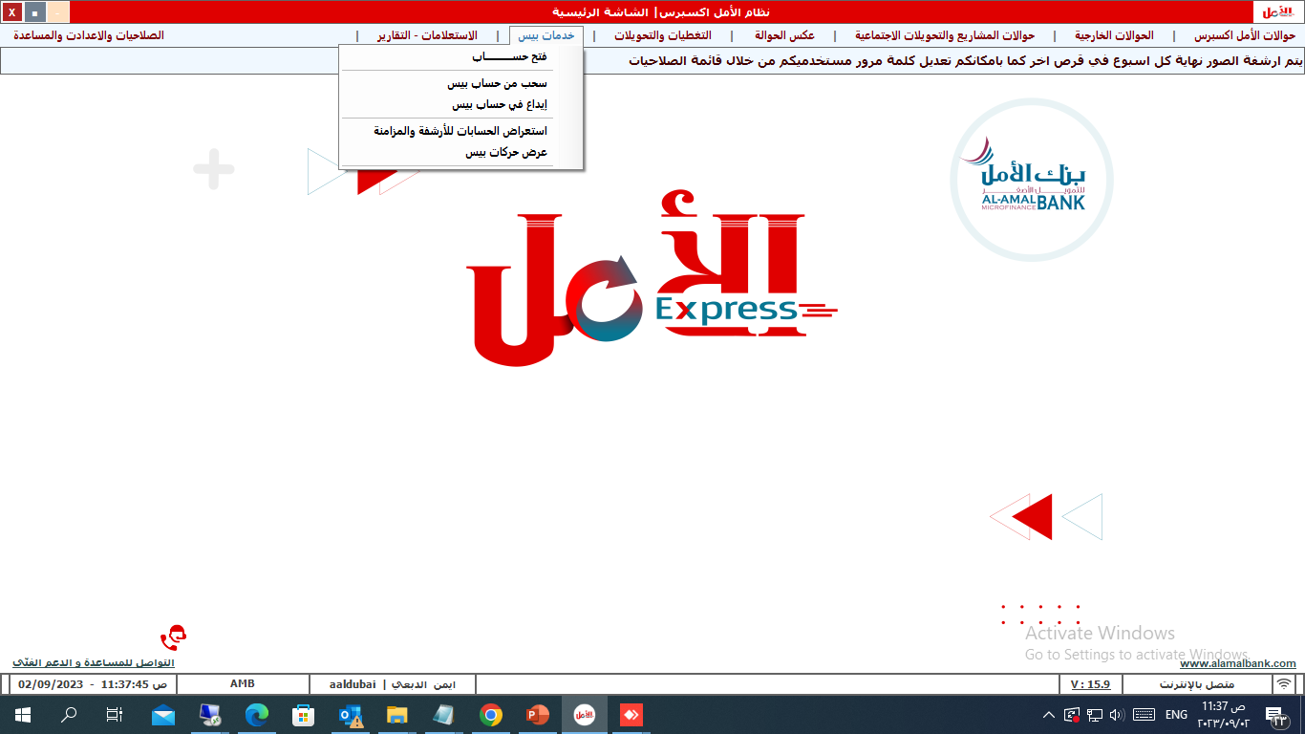
Pyes services screens
5

Slide 35
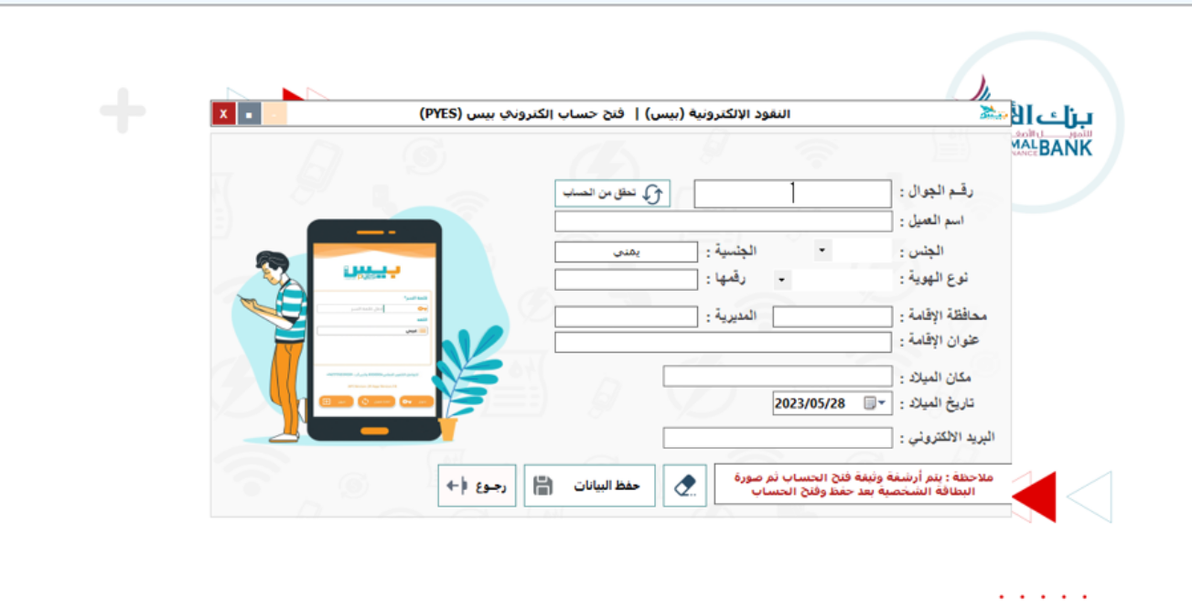
First: Open a Pyes account
Work data (mobile number - client name - gender - nationality - ID type and number - governorate of residence and directorate - residence address - place and date of birth - email
1
2
Click on the save data button
Avery important note

Slide 36
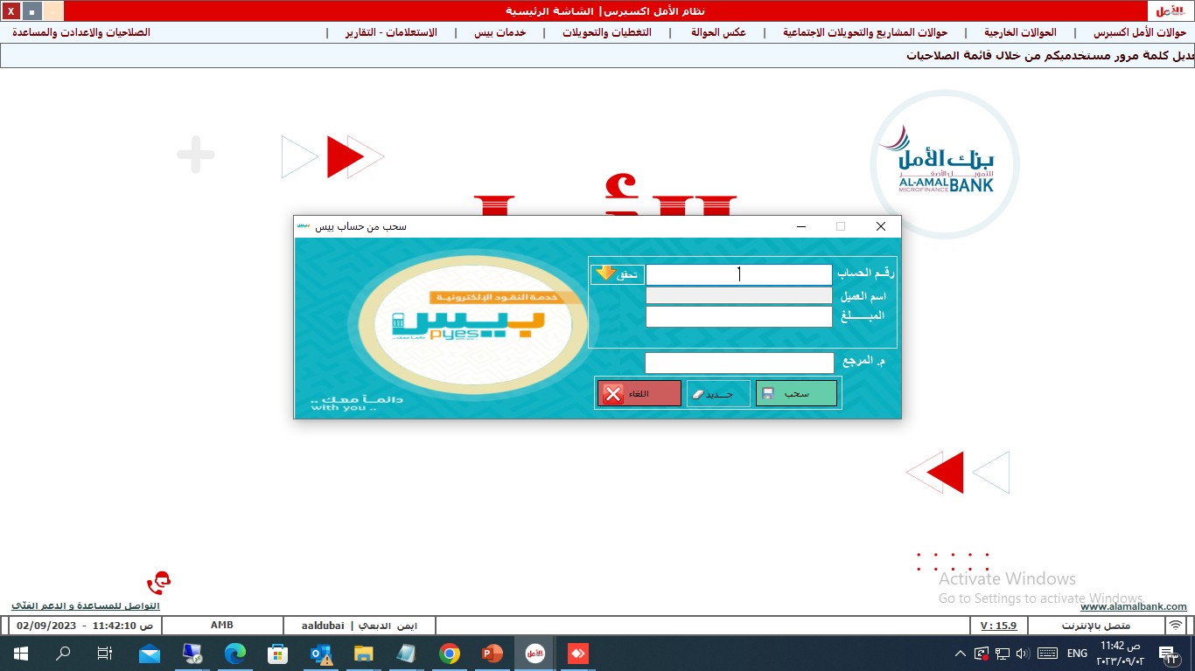
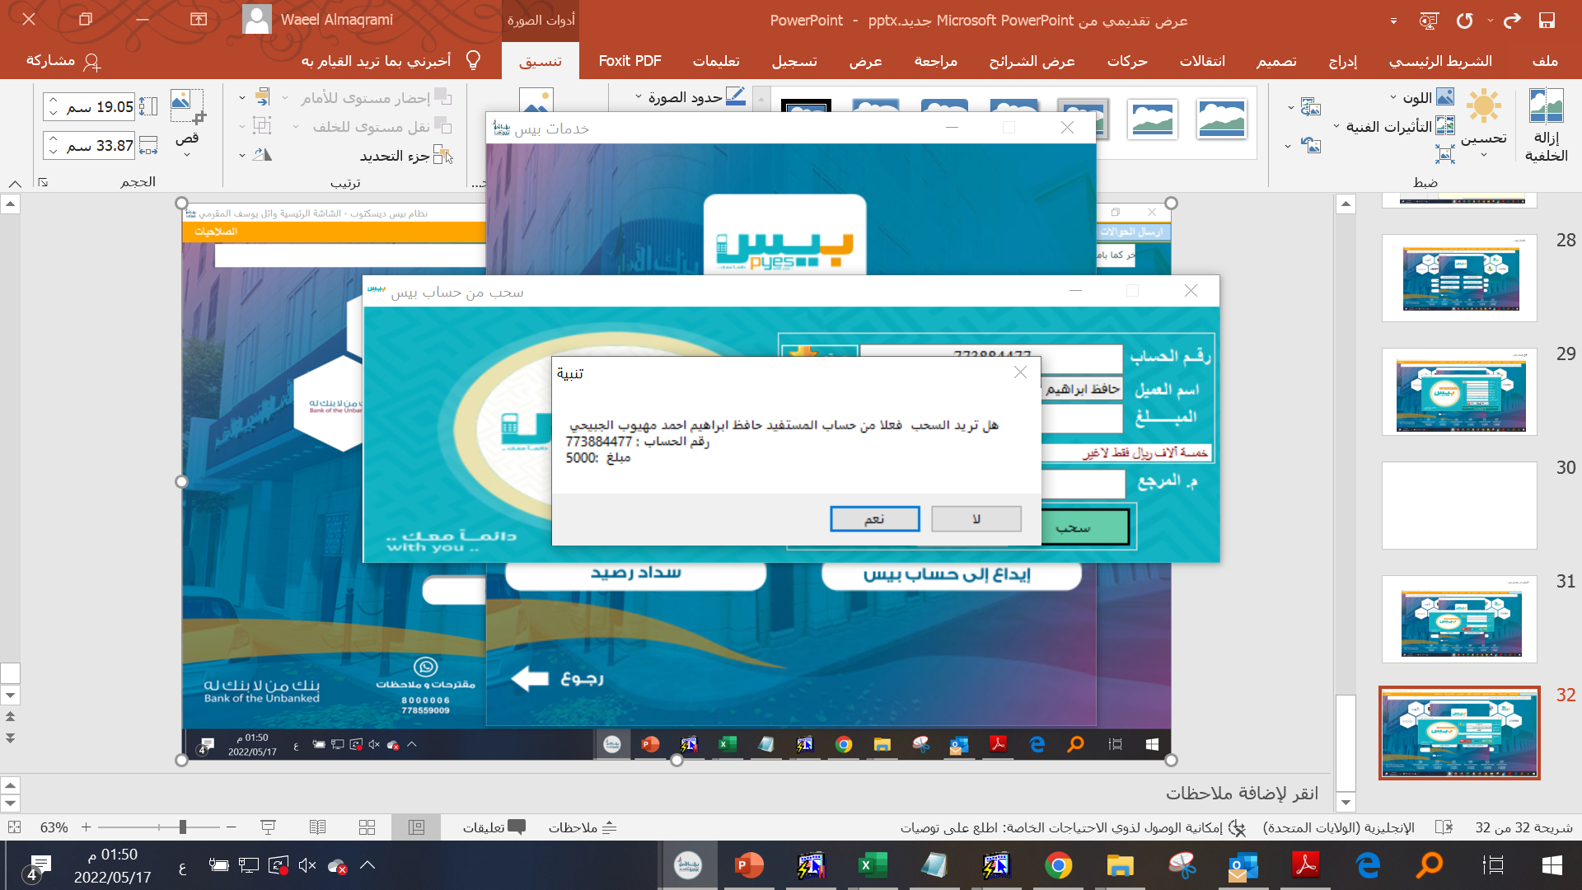
Fifth: Withdrawal from Pyes account
1
2
Enter the account number (mobile number).
Click on (Verify)button
The customer's name appears automatically after verification.
3
Enter the amount you want to withdraw.
4
Click the Withdraw button
5
6
After pressing the withdraw button, this message appears. Click the (Yes) button to withdraw

Slide 37
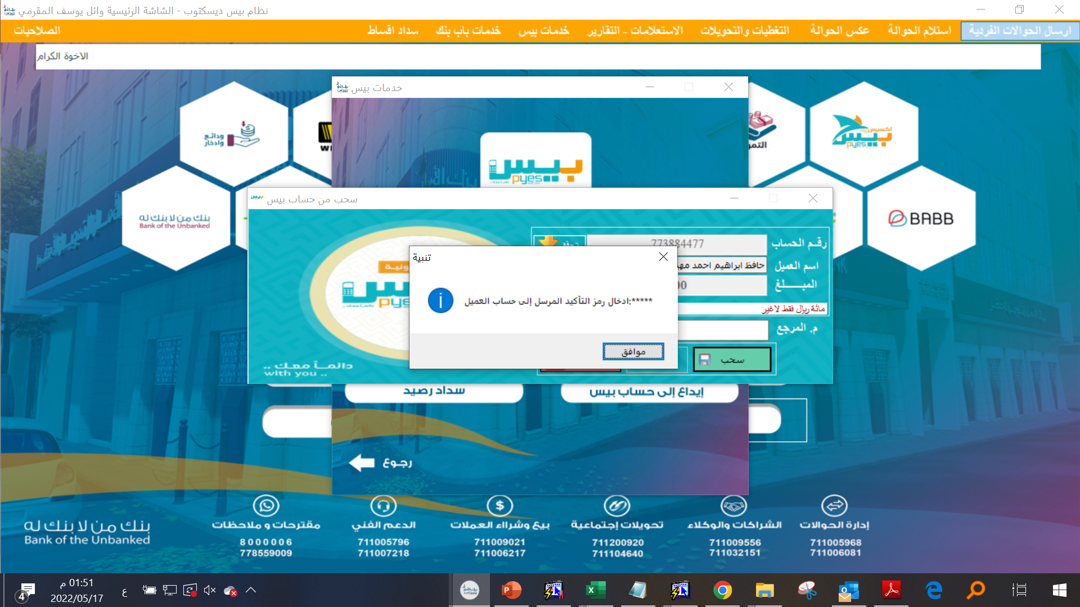


7
After pressing the Yes button, this message appears. The (OK) button is pressed and the code is sent to the customer’s mobile phone
8
The customer will be asked for the confirmation code that was sent to his mobile phone and write it in this box, then press the (Yes) button.
9
This message indicates that the withdrawal process has been completed successfully and the (OK) button has been clicked.

Slide 38


10
After pressing the OK button, this message will appear. To print the bond, click the (OK) button.
11
The bond is printed by clicking on the printer icon
12
After printing the bond, the customer is asked to sign the bond in the box

Slide 39


Second: Deposit into the Pyes account
1
2
Enter the account number (mobile number)
Click on (verify) button
3
The customer's name appears automatically after verification
Enter the depositors name
4
5
Enter the amount you want to deposit
6
Click on the deposit button

Slide 40


7
After clicking the Deposit button, this message appears. Click the (Yes) button.
8
After clicking the (Yes) button, this message appears. Click the (OK) button to deposit

Slide 41

9
The customer will be asked for the confirmation code that was sent to his mobile phone and write it in this box, then press the (Yes) button.
10
The customer will be asked for the confirmation code that was sent to his mobile phone and write it in this box, then press the (Yes) button.

Slide 42


Third: Review accounts for archive and synchronization
1
Enter username
3
2
Determine the date of opening the account
Click on the View Open Accounts button

Slide 43


Ninth: Showing Pyes's movements
1
Enter username
3
Determine the history of Pace's movements
Click the View button
2

Slide 44


Inquiries - Reports

Slide 45

First: Review the remittances disbursed and the archive
5
Exporting disbursed remittances to Excel
Click on the Print Transfer Document button
Choose a username
4
1
3
Determine the date of disbursement of transfers
Click on view a daily report of disbursed transfers
2

Slide 46


Second: Comparing disbursed remittances with archived and synchronized remittances
Determine the date of disbursement of transfers
Specify the image folder path
3
2
chooes the user name
Click on the button to view a daily report of disbursed transfers
1
4
All transfers will be displayed
5
Click on the Sync All Transfers button
6

Slide 47


Third: A general inquiry about the beneficiary’s status
Enter the beneficiary number - the transfer number
Click on the Search and Inquire button
2
1

Slide 48


View account statement
Click on the View Detection button
4
2
Choose account
3
1
Specify the period for which you want to display the statement
Click on fetch accounts

Slide 49


Permissions, setting and help

Slide 50


First: User Permissions
Click on the View Data button
2
1
Enter a username
The user data and the permissions granted to him will be displayed
3

Slide 51


Second: Change the password
Enter your current password
1
2
Change the password and confirm it again
Click on the Update button password
3

Slide 52



Third: Preparing the exchange team
Enter team data
1
2
3
Click the save button
Determine the attendance time and departure time
Edit status for team members
Click the save button

Slide 53


Fourth: Entering the daily report
Specify all the data to be uploaded to the daily report by choosing from the drop-down menus next to each field
Click the Post button

Slide 54


Fifth: Reset/update the system configuration
After clicking on Update System Configuration, a bar will be displayed at the bottom of the screen that automatically retrieves the latest system updates

